Slide 1

Inside counts: communicating your data story
Janet S. Oh,
Senior Director, Institutional Research
CSU Northridge

Slide 2

GI2025
Data-informed strategies
Student Success Data Workshops
Inquiry based
Diverse audiences
Data Champions
College-appointed faculty
Dual responsibilities
Inside Counts
Website repository with keywords
Accompanied by email campaign
Brief reports with graphics

Slide 3
Why is data-informed decision making so hard?
{ The backfire effect }
Ease into it
Allow for discovery
Find your in-group
Data storytelling

Slide 4
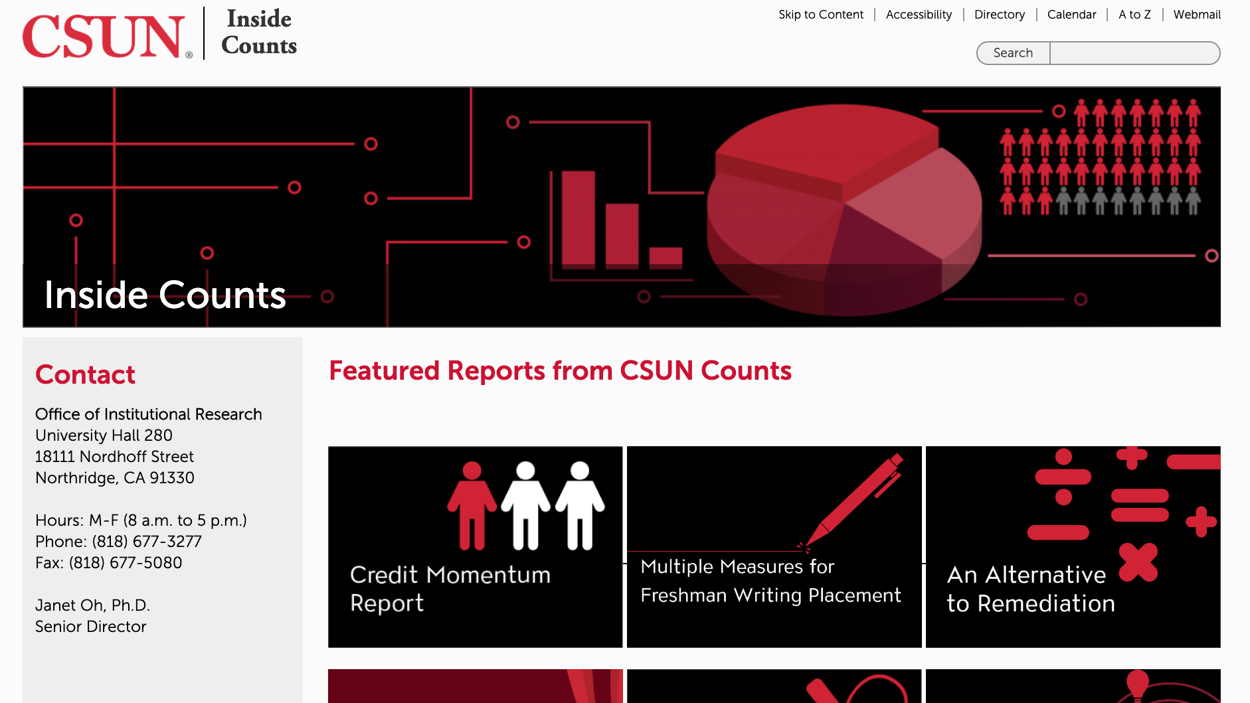
Inside counts: data for “non-numbers” people

Slide 5

Get them interested: email strategy

Slide 6
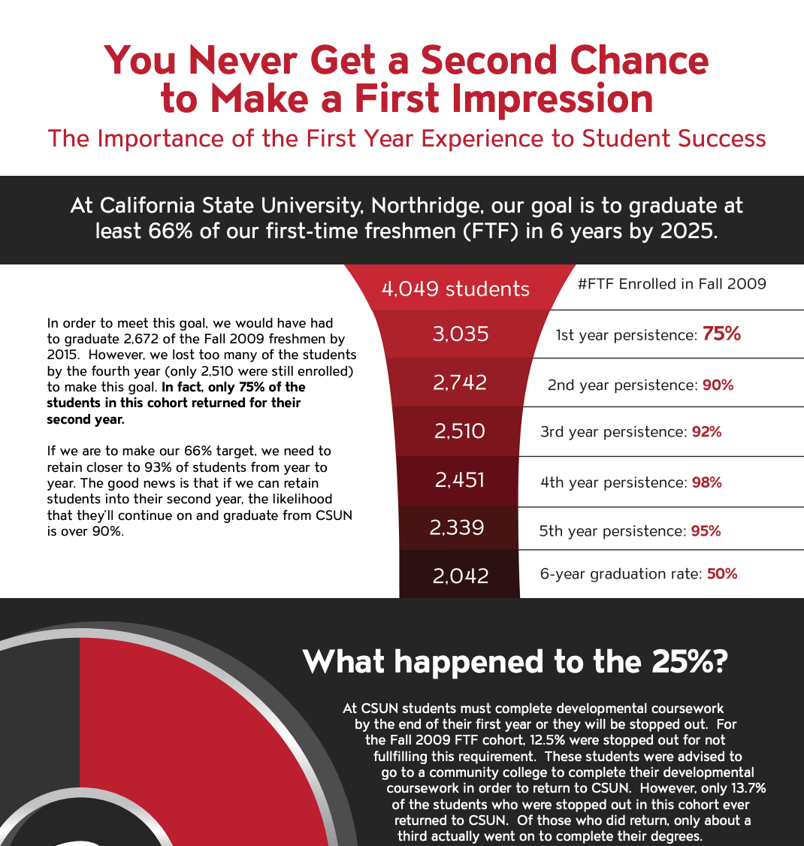
EASE INTO IT:
FRESHMAN RETENTION

Slide 7
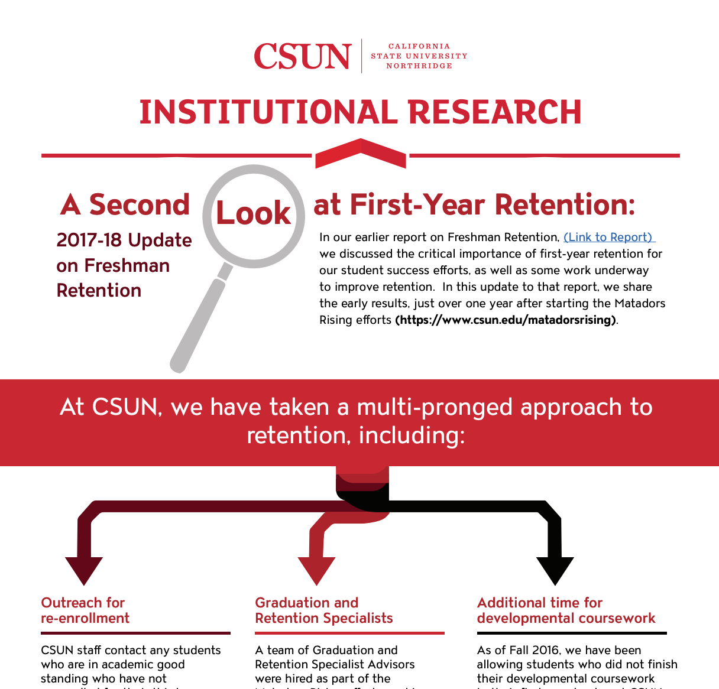
AND A LITTLE MORE:
FRESHMAN RETENTION UPDATE

Slide 8
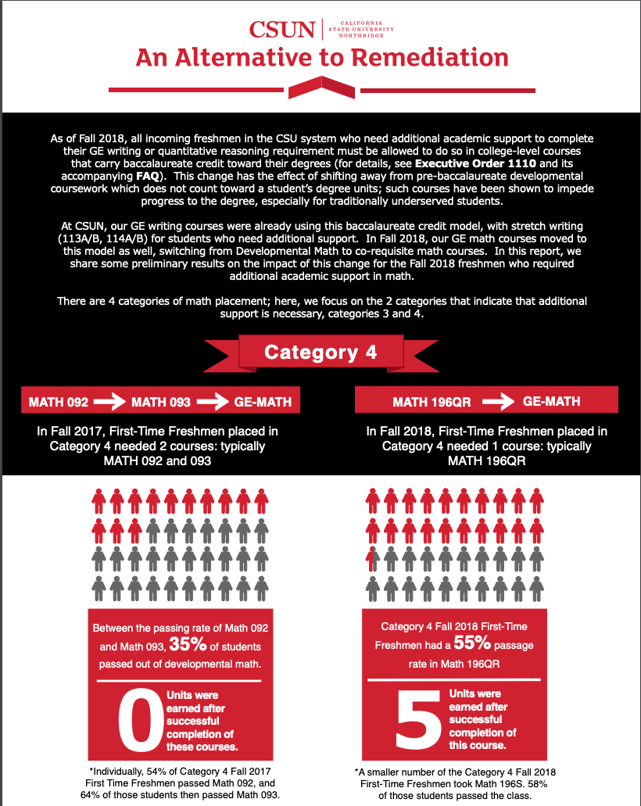
INSIDE COUNTS:
A COMMUNICATION TOOL FOR CHANGES WITH EO 1110

Slide 9
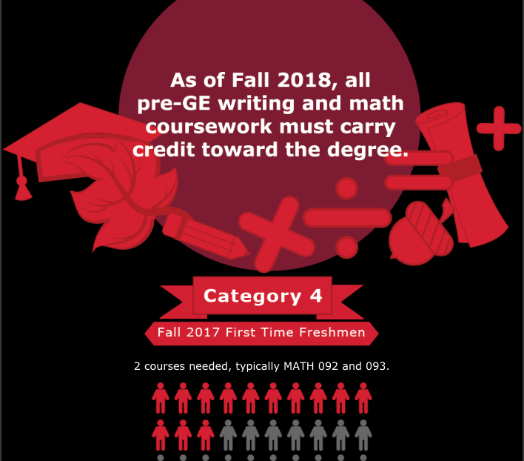
EMAIL CAMPAIGN:
EO 1110 CHANGES

Slide 10
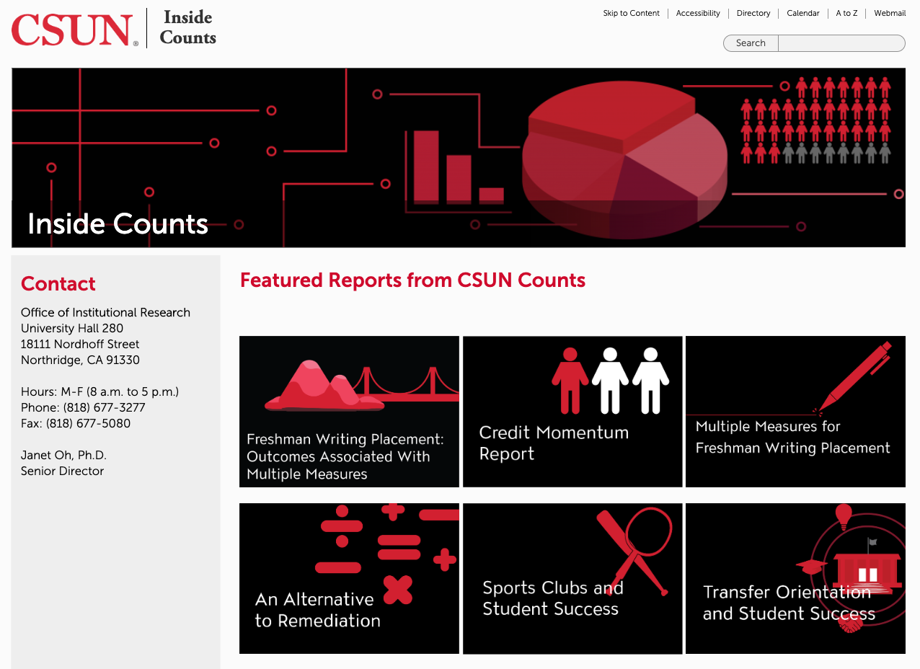
Upcoming feature: keyword search/grouping

Slide 11
Inside counts: a training platform
Graphic design intern
Graduate student data interns

Slide 12


Inside counts: an evolving data story
https://www.csun.edu/institutional-research/inside-counts
JANETOH@CSUN.EDU @JANETOH47

