Slide 1
PLUM @ Sac State:
Empowering Students in Entry-Level Math Courses
Angela Clark-Oates, Writing Program Coordinator, Department of English
James German, Dean, Office of Graduate Studies
Bridget Parsh, Director, First Year Experience
Shiva Pillai, Analyst/Programmer, Institutional Research, Effectiveness, and Planning
Joel Schwartz, University Initiatives and Student Success
David Zeigler, Chair, Department of Mathematics and Statistics

Slide 2
What is PLUM?
Placement, Learning, and Understanding Mathematics
Guided system, consisting of a self-inventory and a QR activity, for all students to assess and improve their QR knowledge.
Part of our University Plan to assess student math readiness to learn

Slide 3
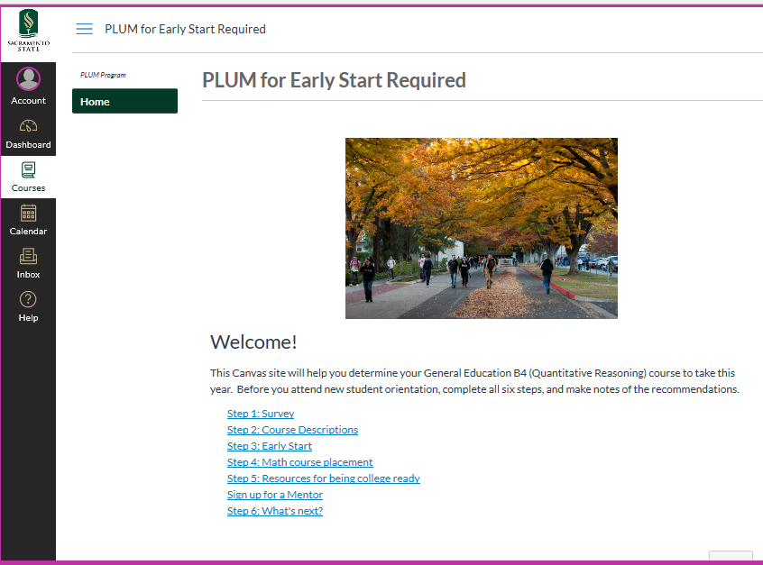
Notes:
zeigler

Slide 4
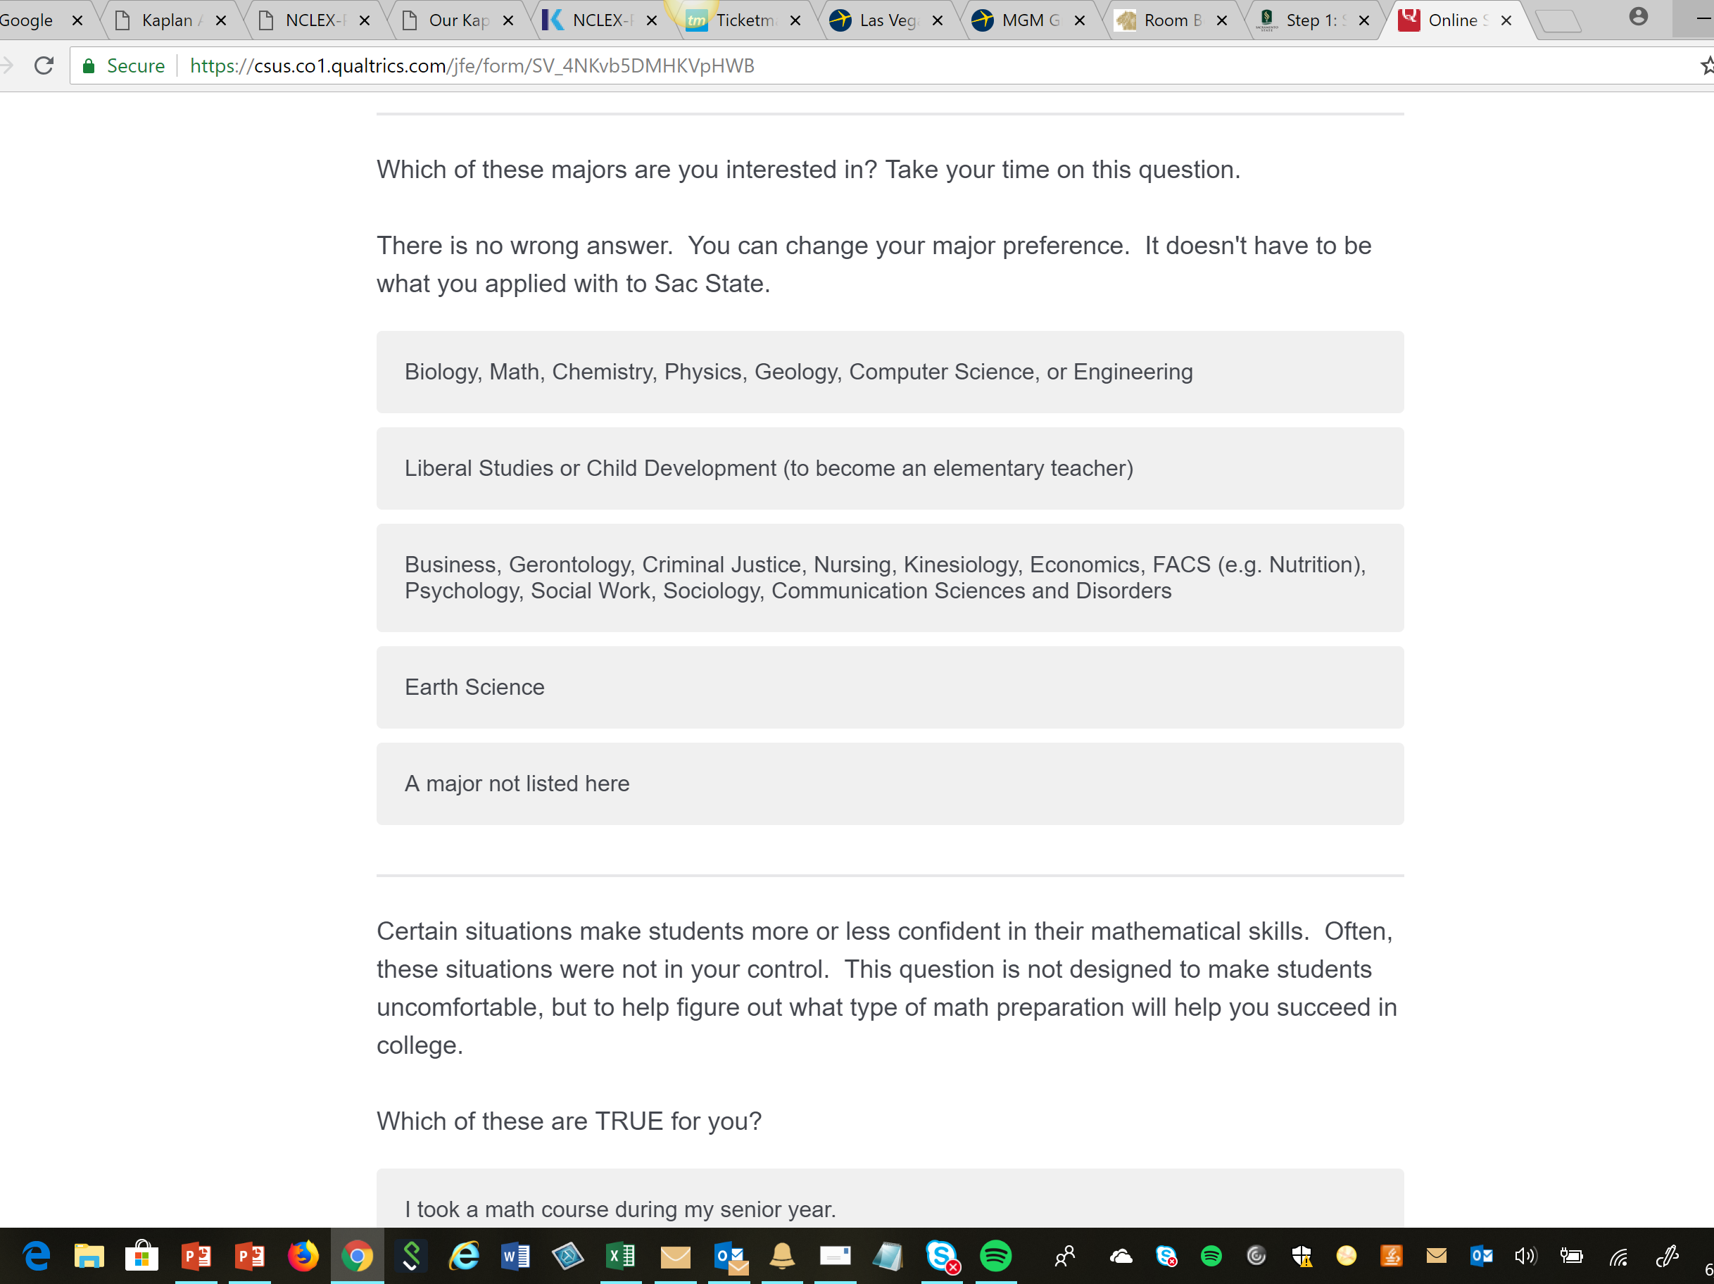
Notes:
parsh

Slide 5
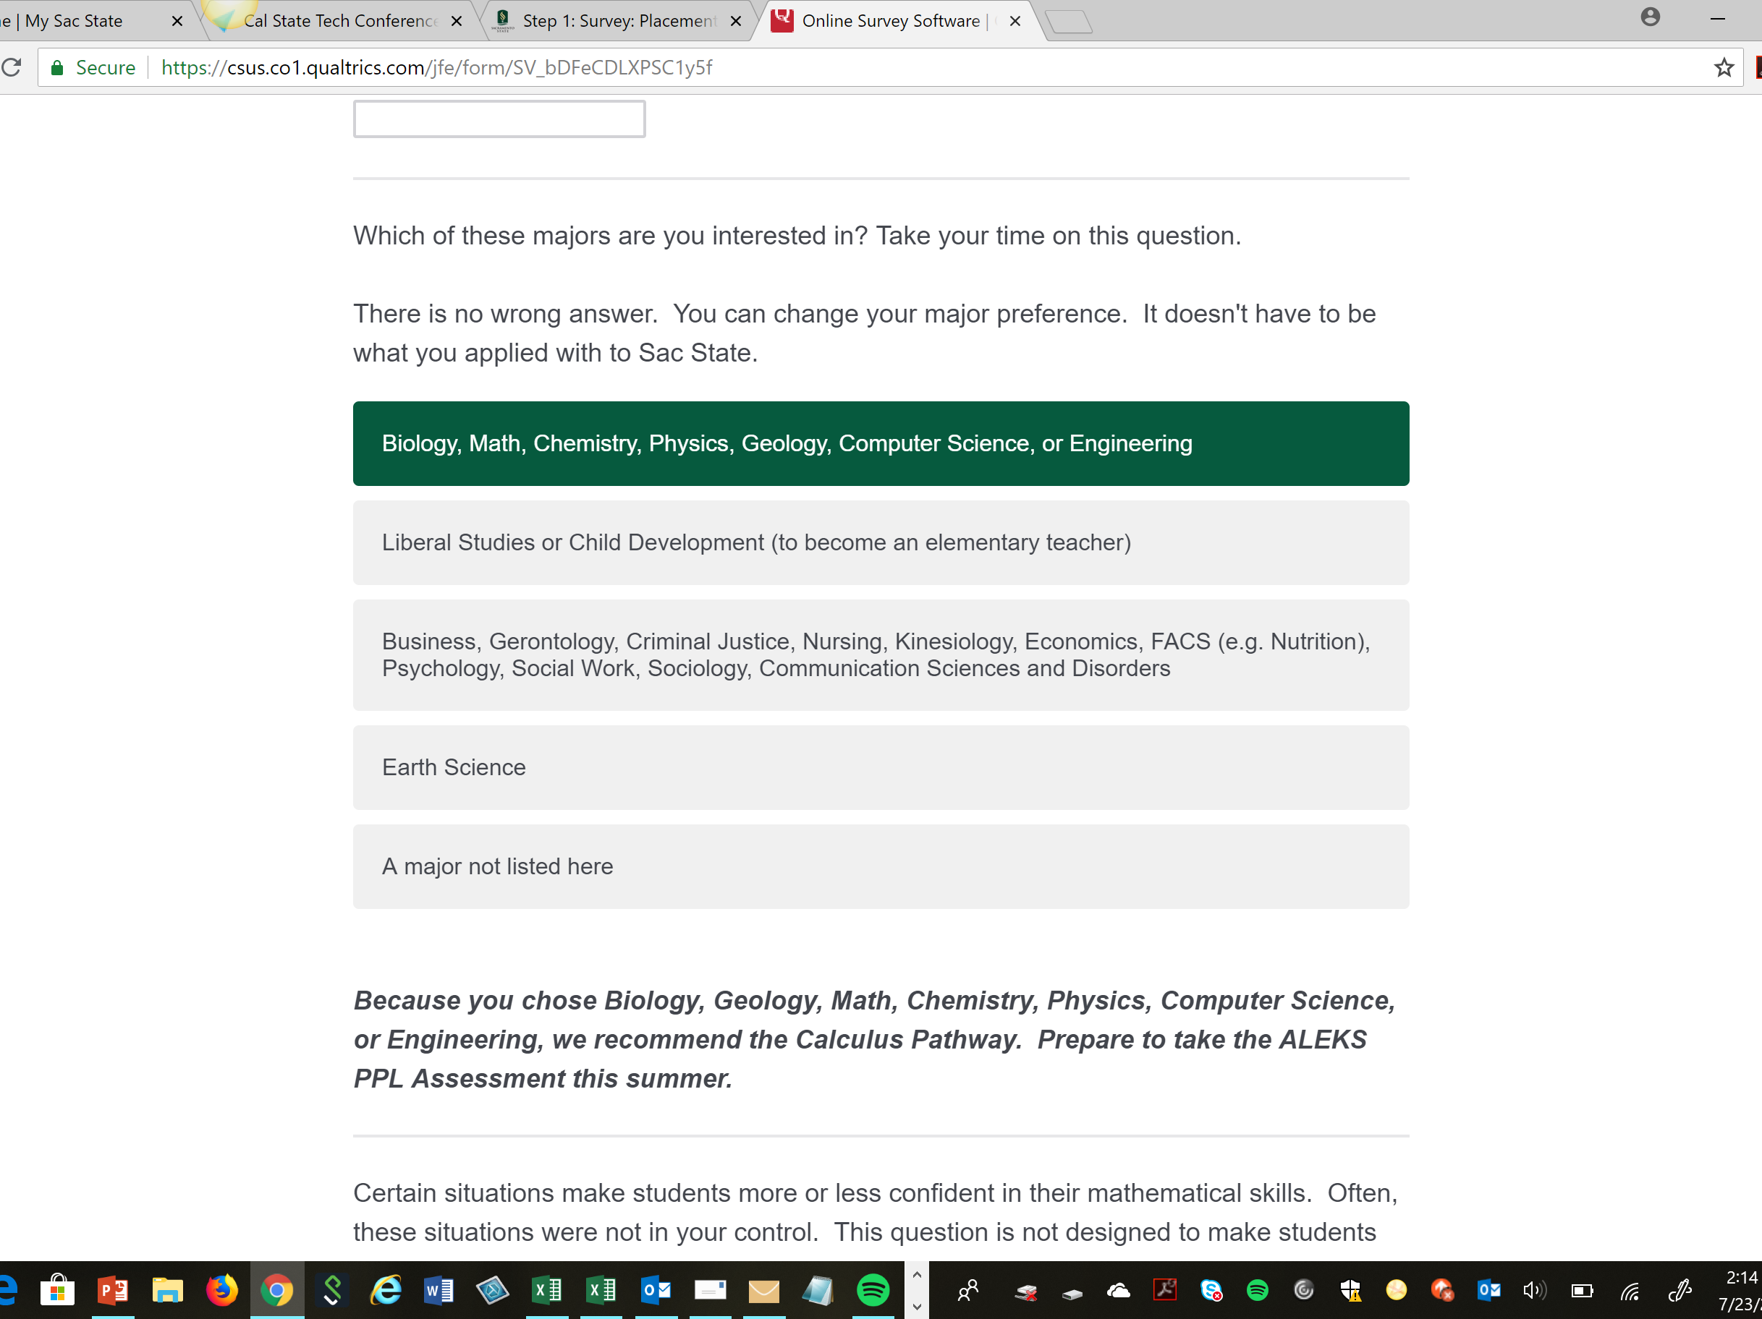
Notes:
parsh

Slide 6
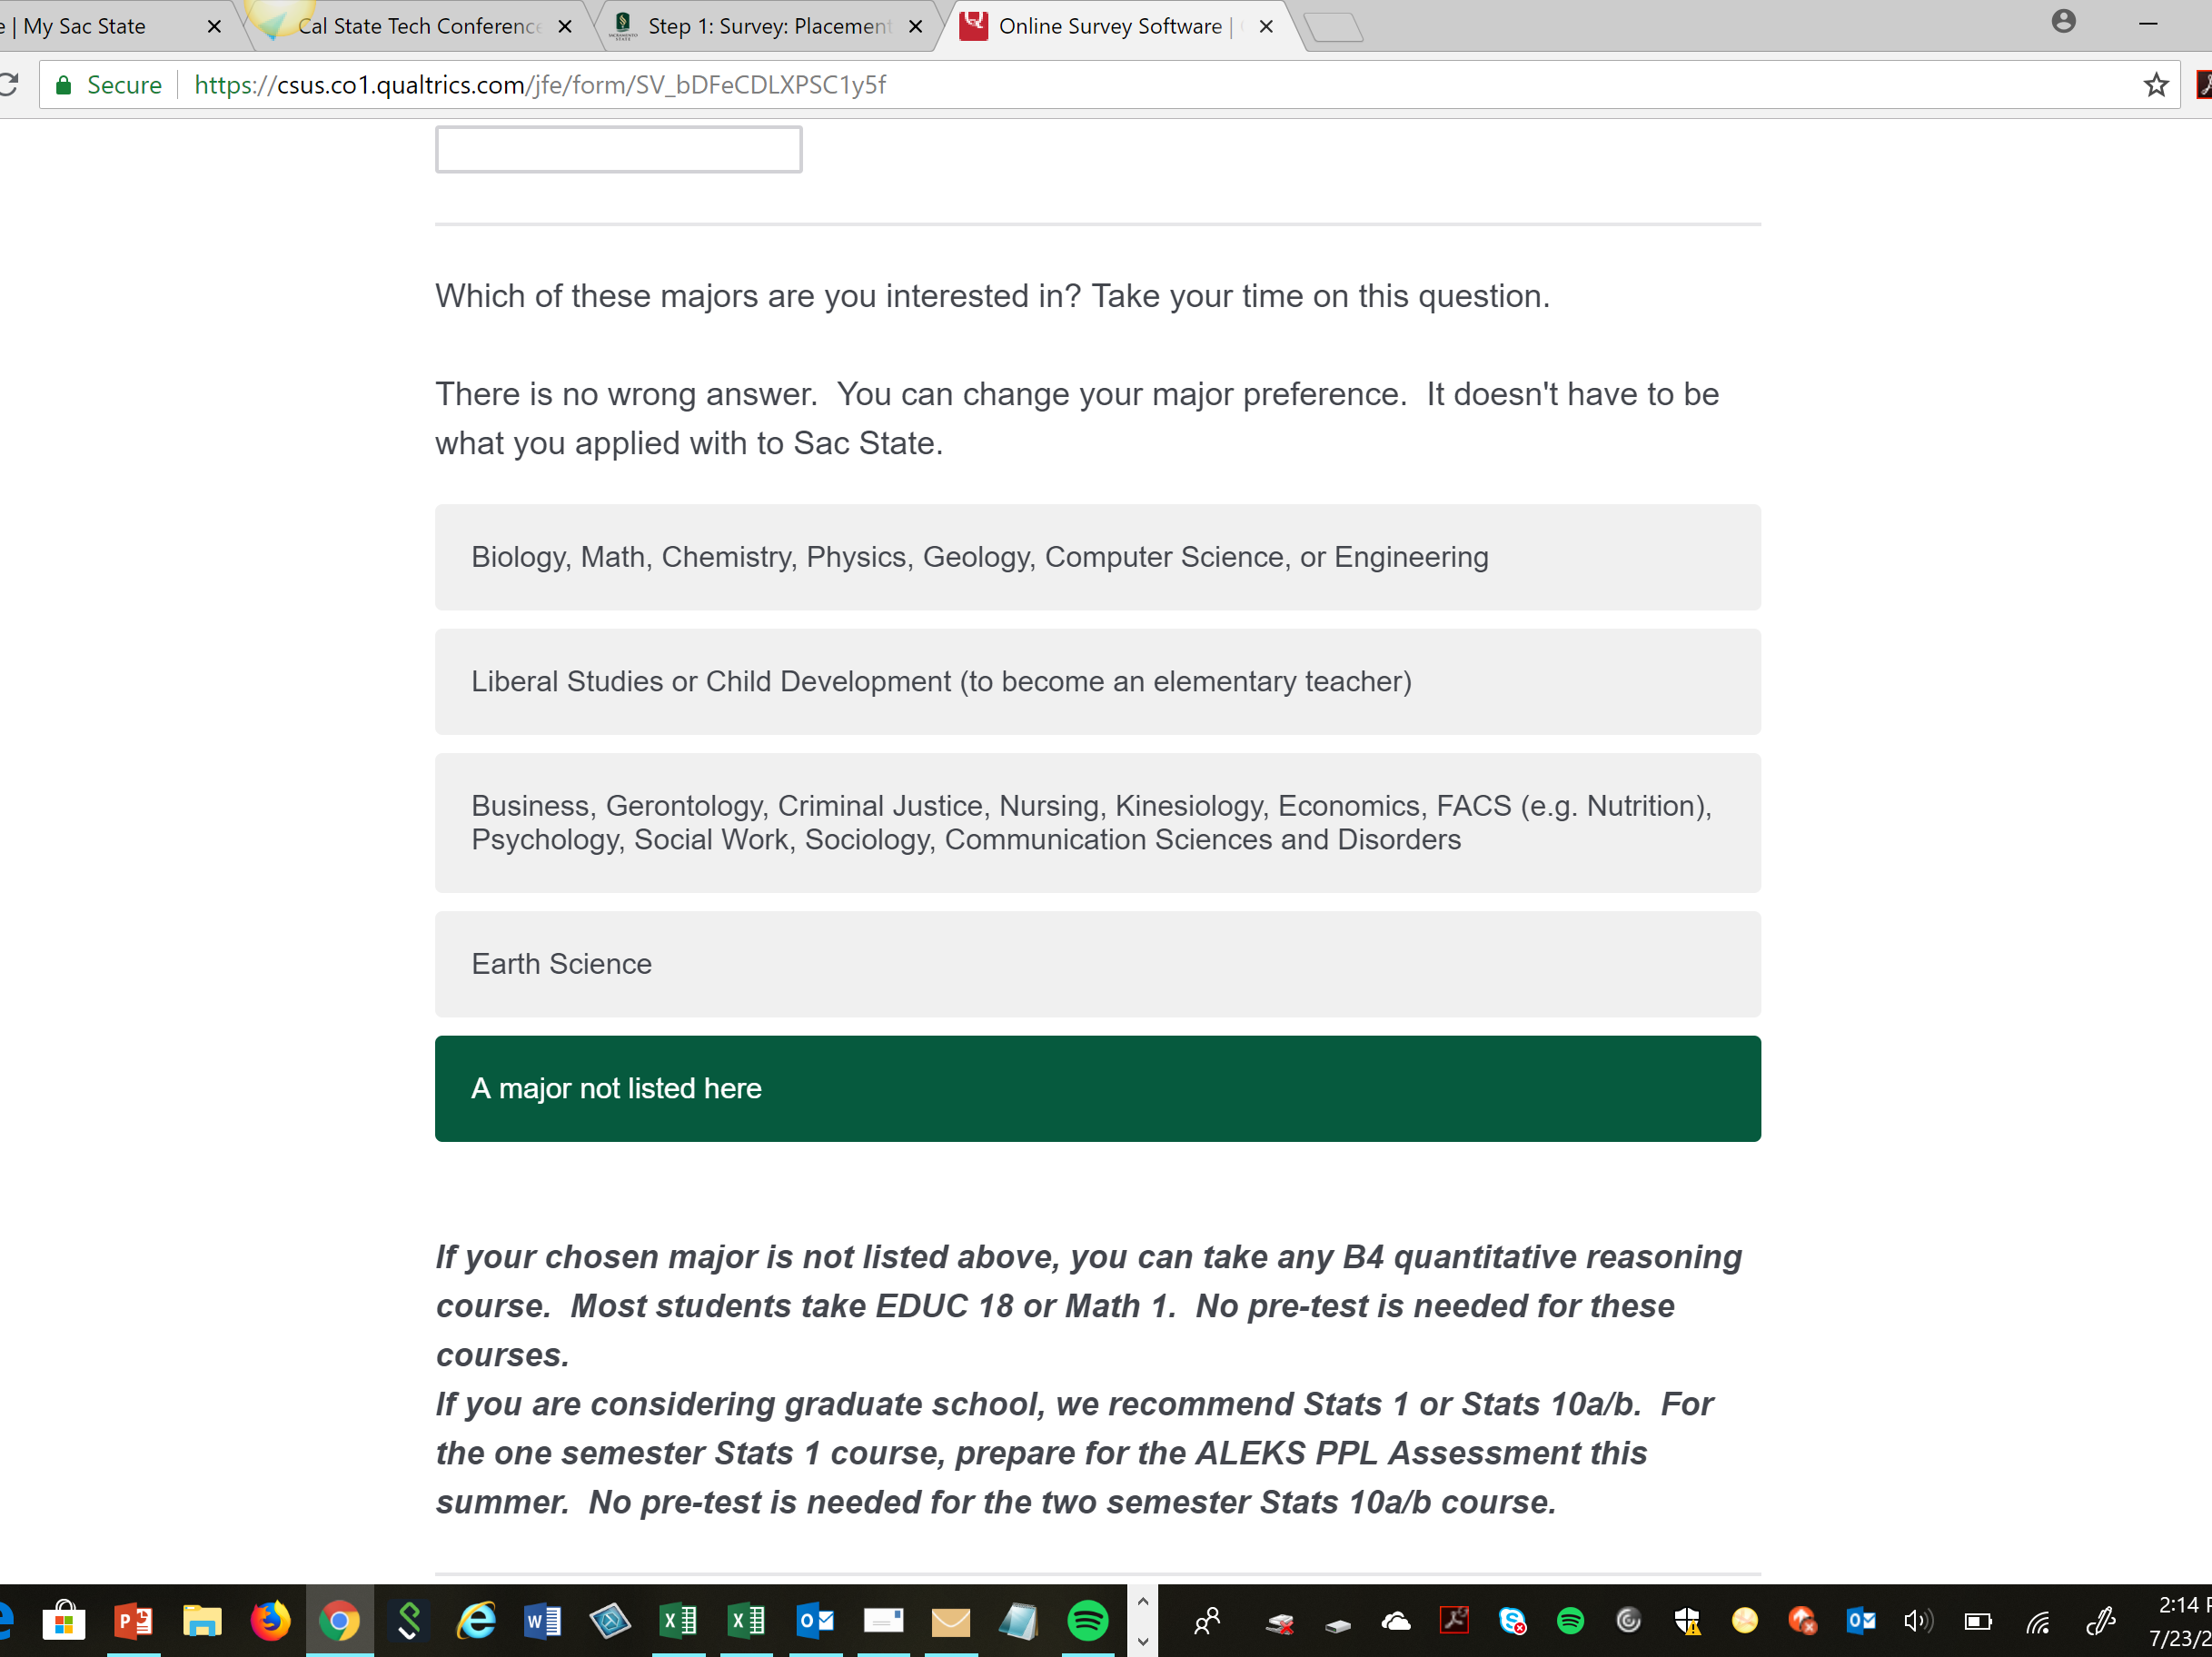
Notes:
parsh

Slide 7
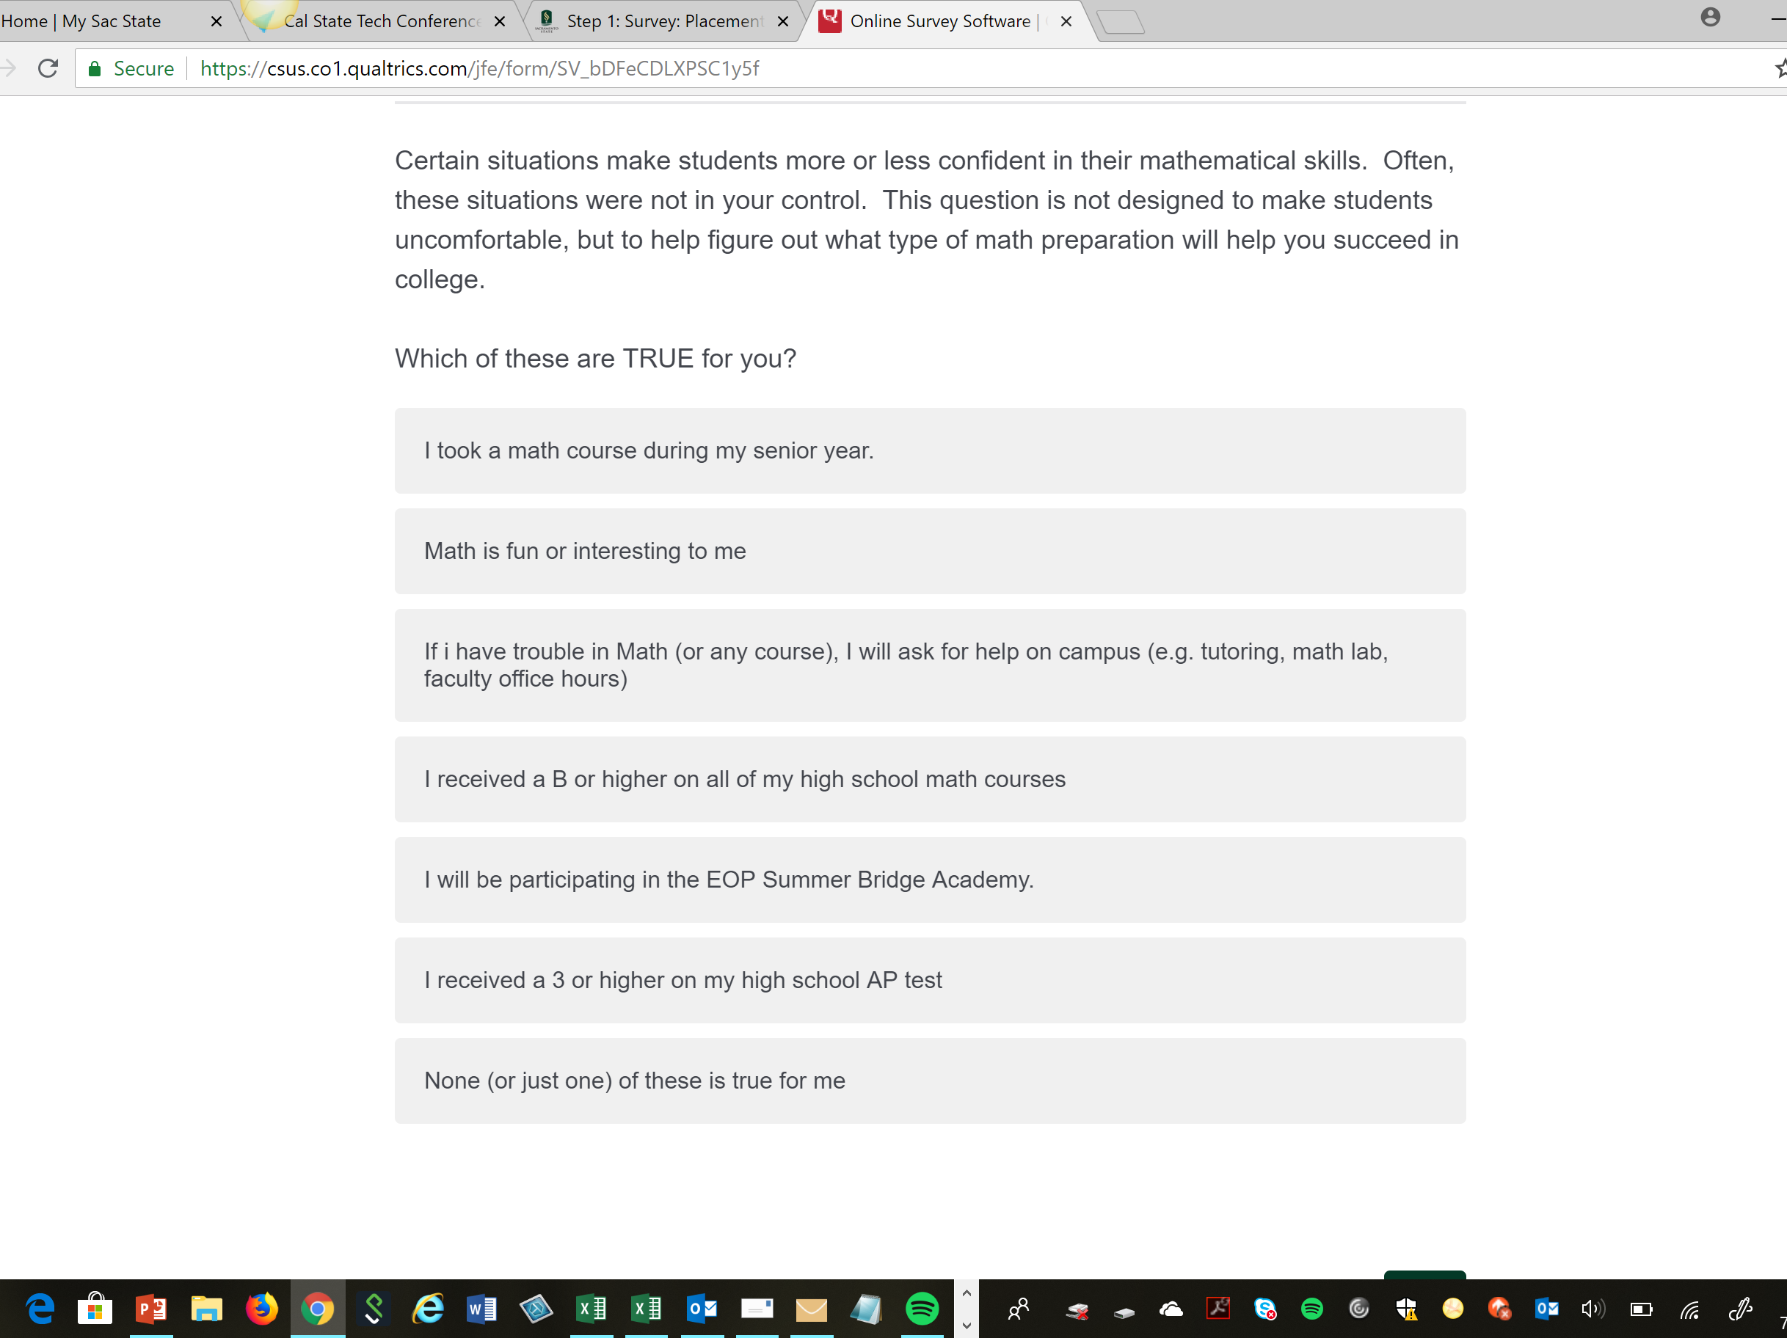
Notes:
parsh

Slide 8
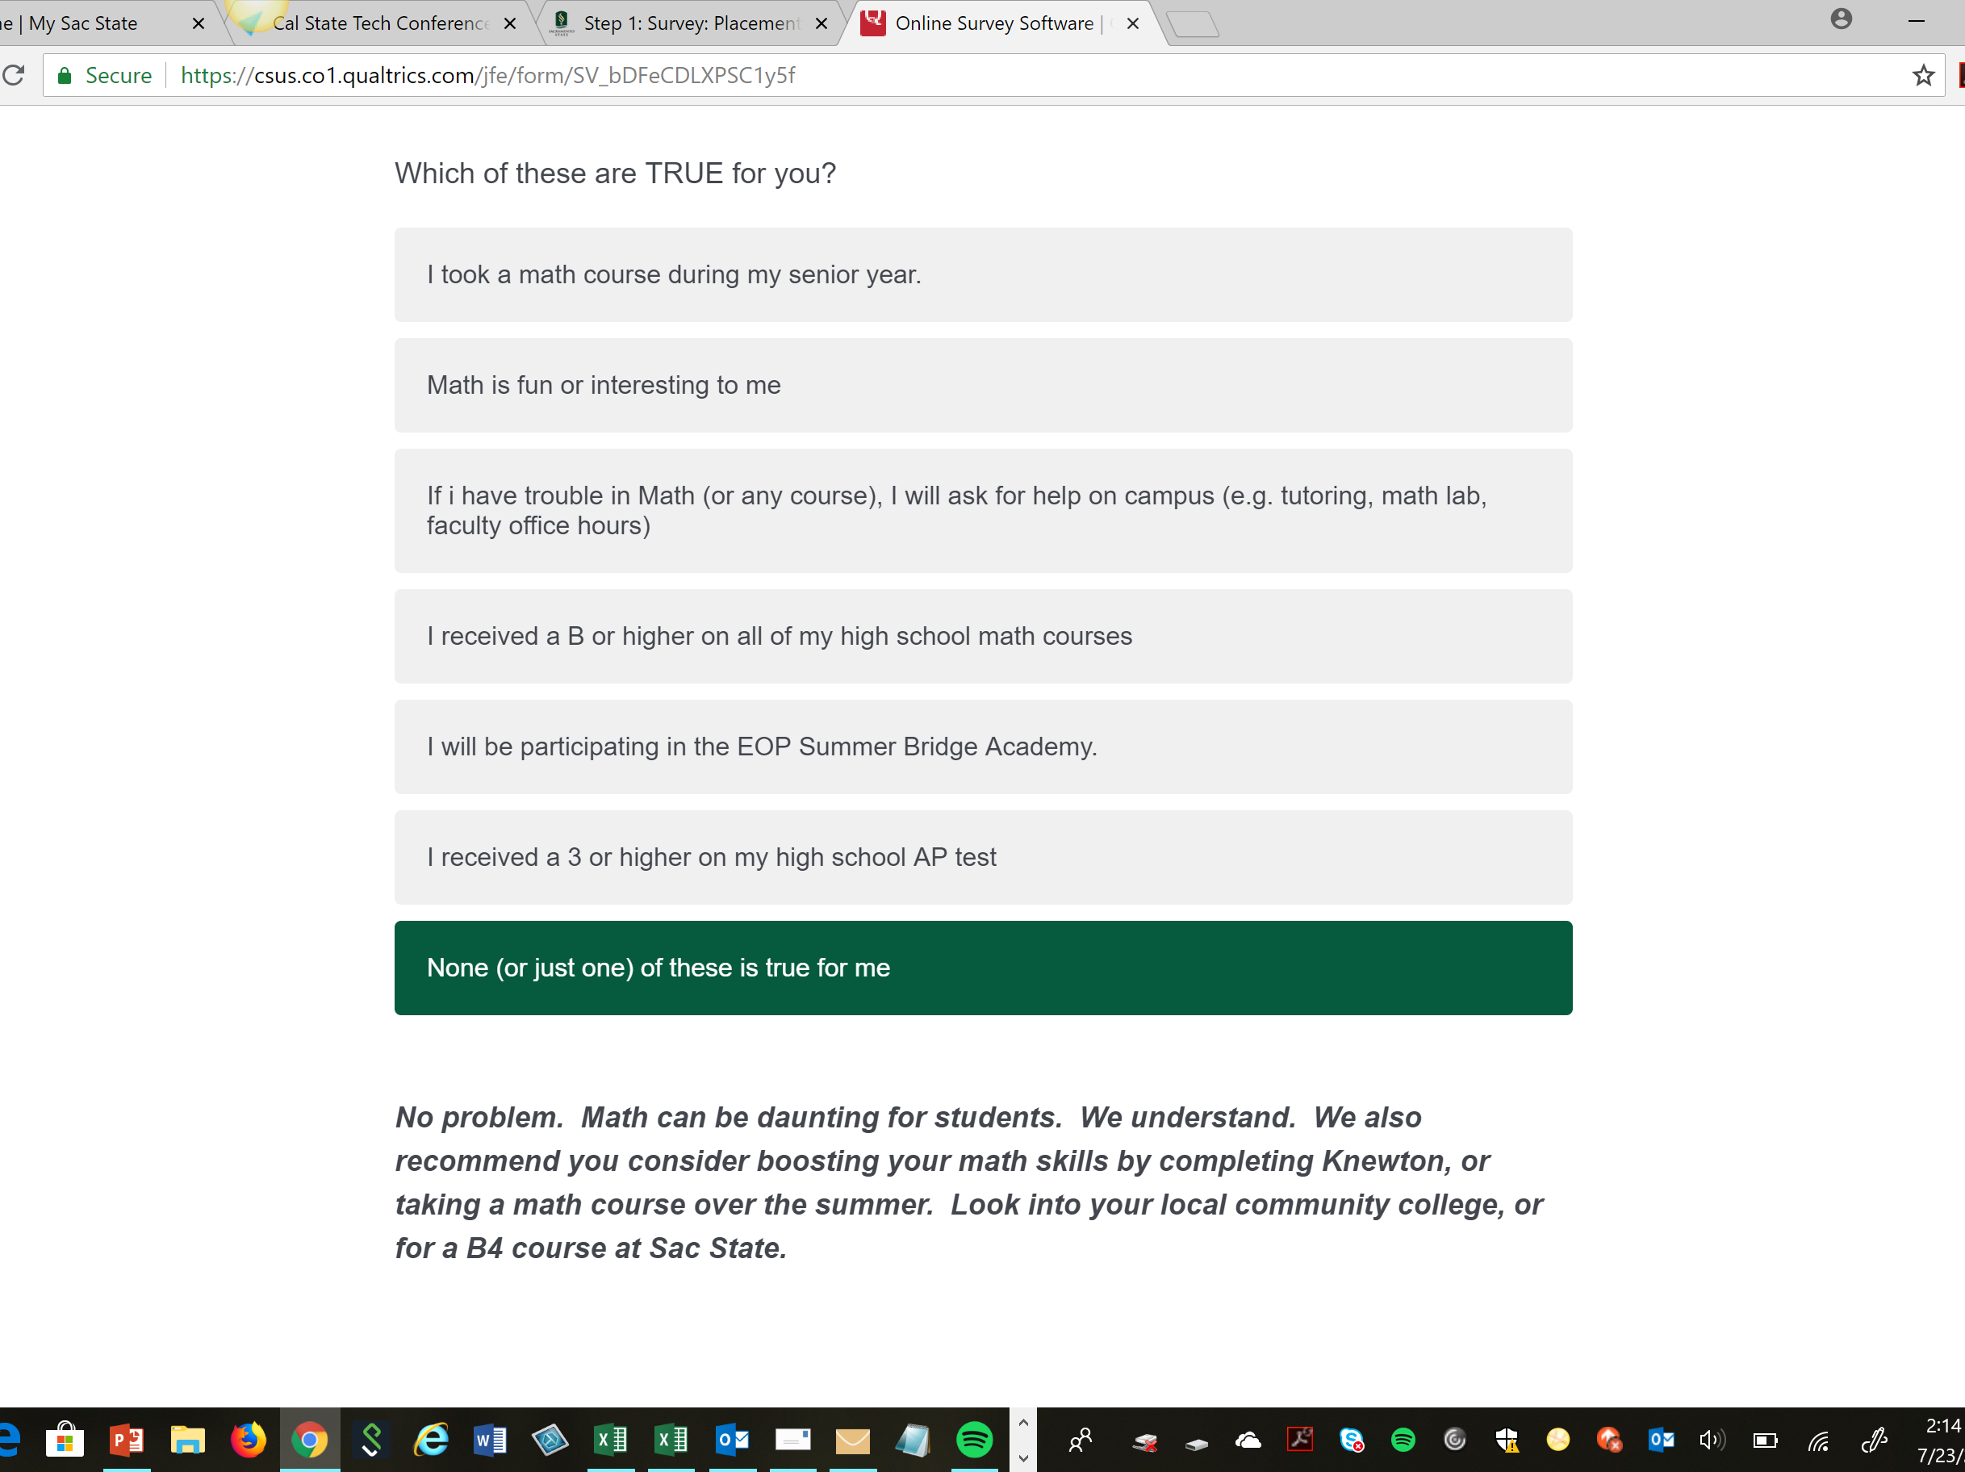
Notes:
parsh

Slide 9
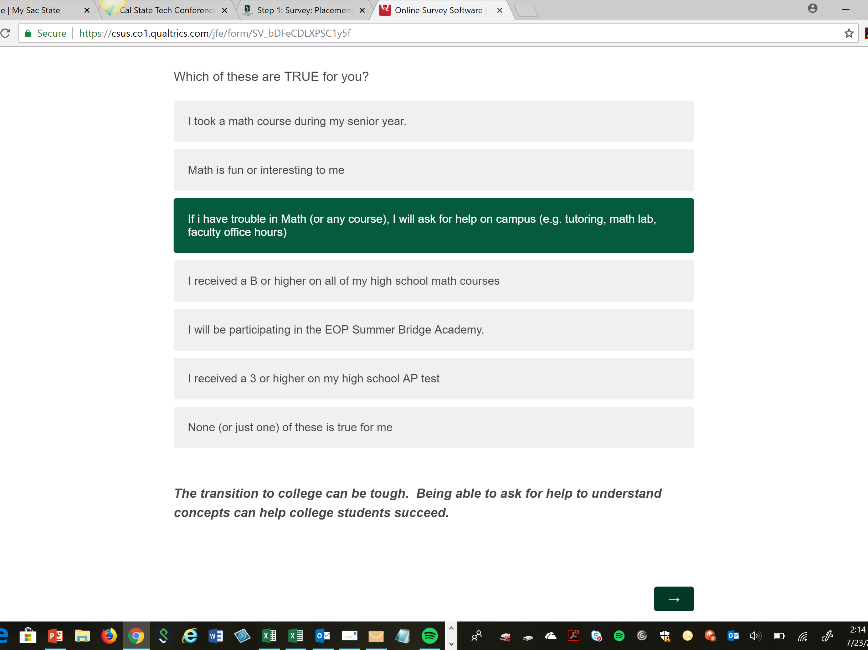
Notes:
parsh

Slide 10
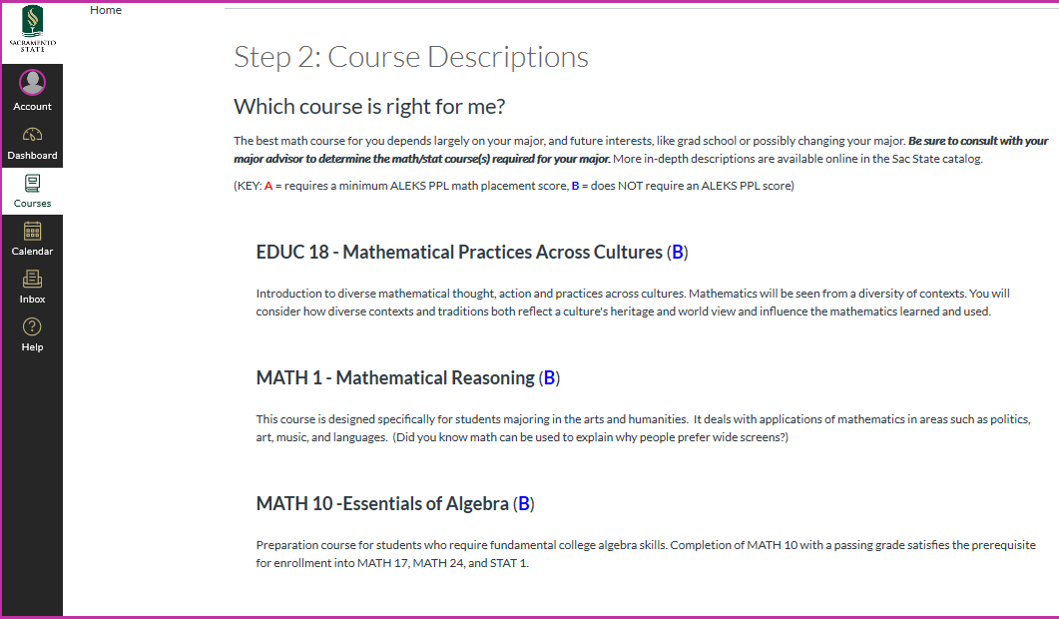
Notes:
parsh

Slide 11
Notes:
zeigler

Slide 12
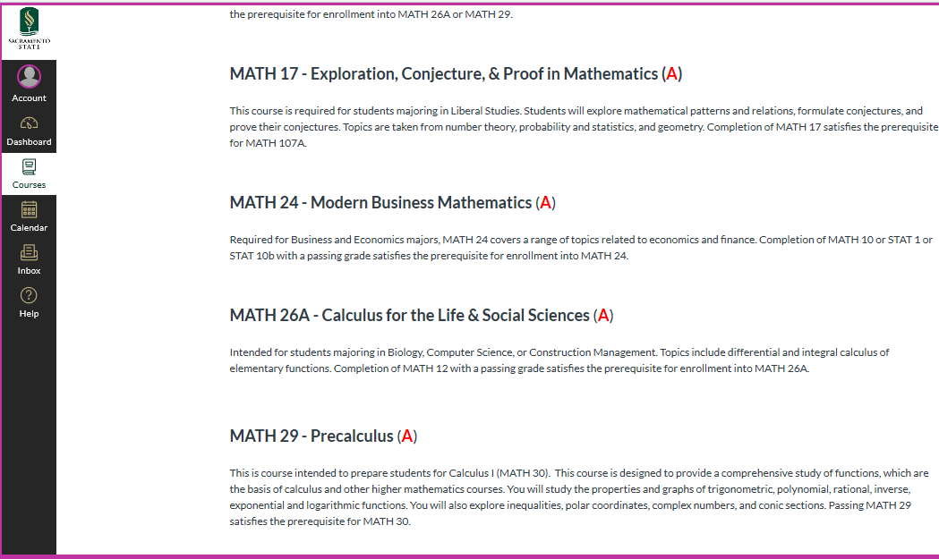
Notes:
zeigler

Slide 13
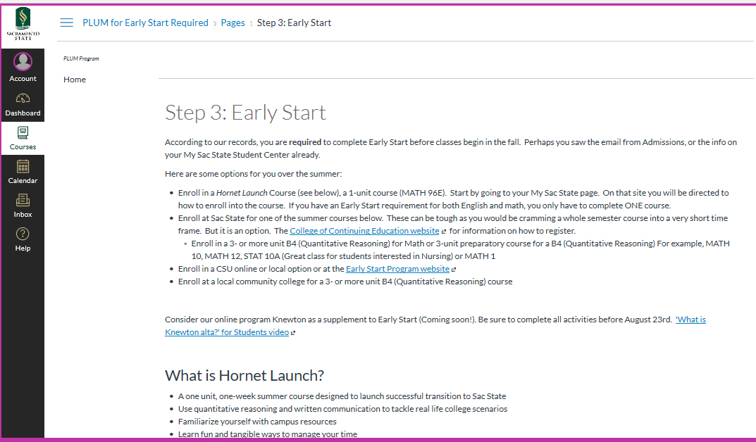
Notes:
zeigler

Slide 14
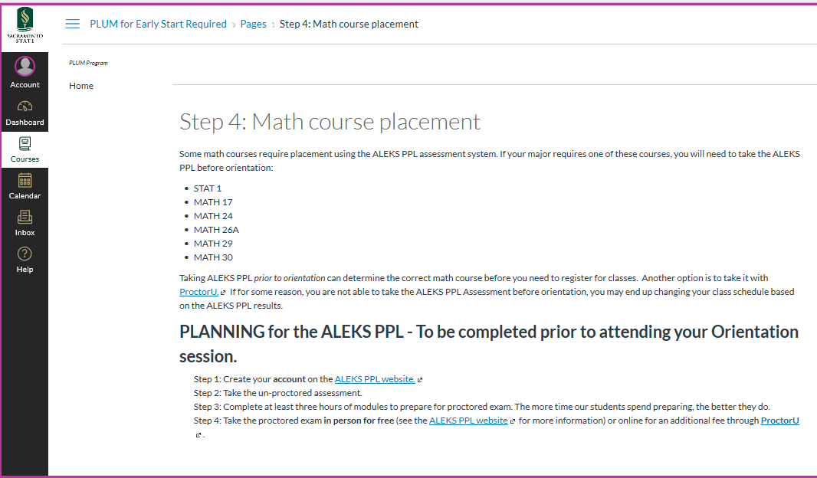

Slide 15
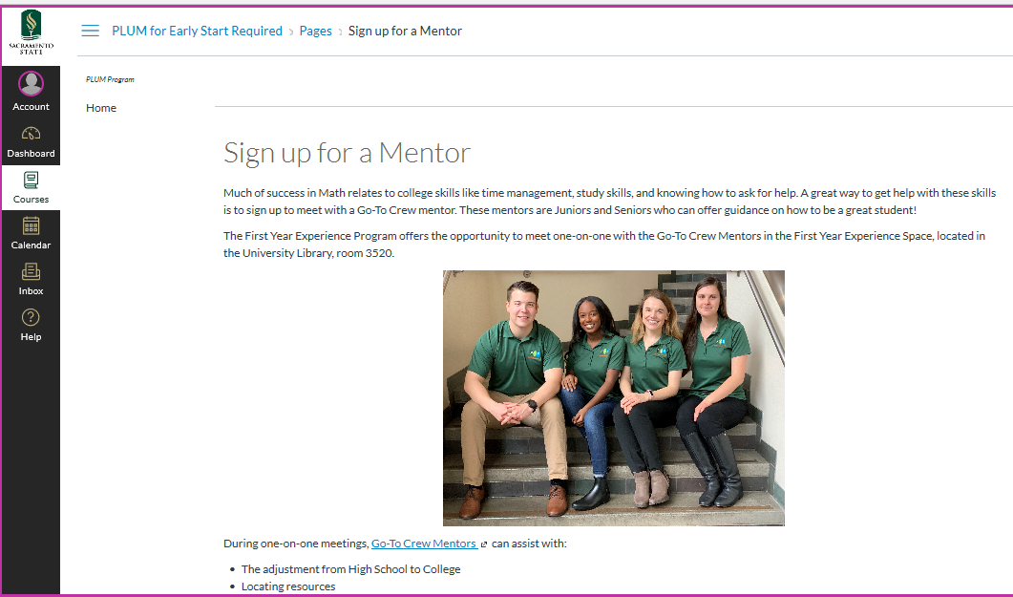
Notes:
parsh

Slide 16
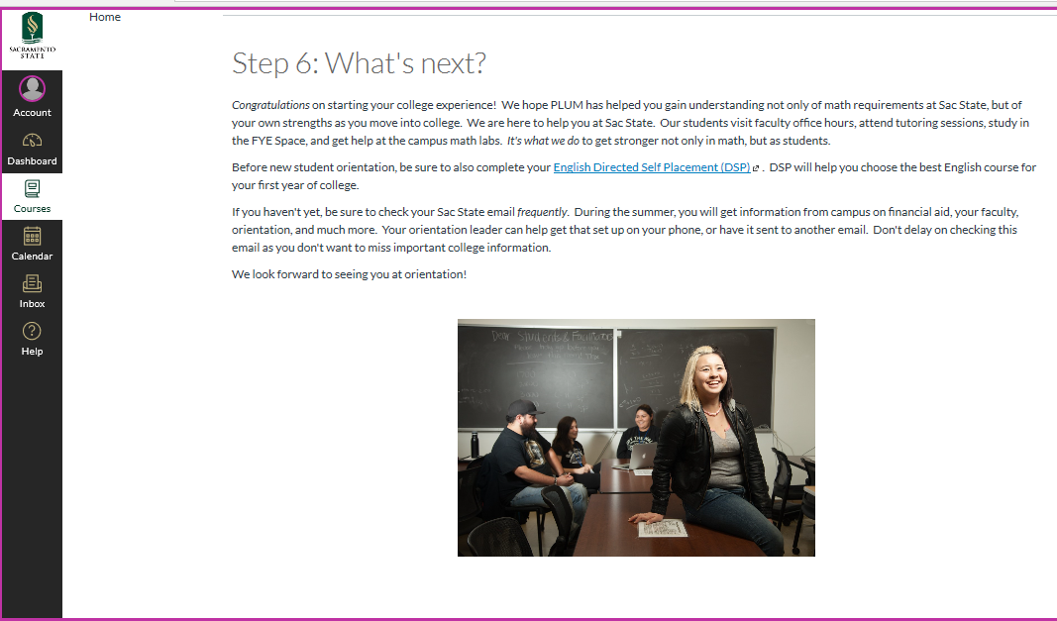
Notes:
parsh

Slide 17
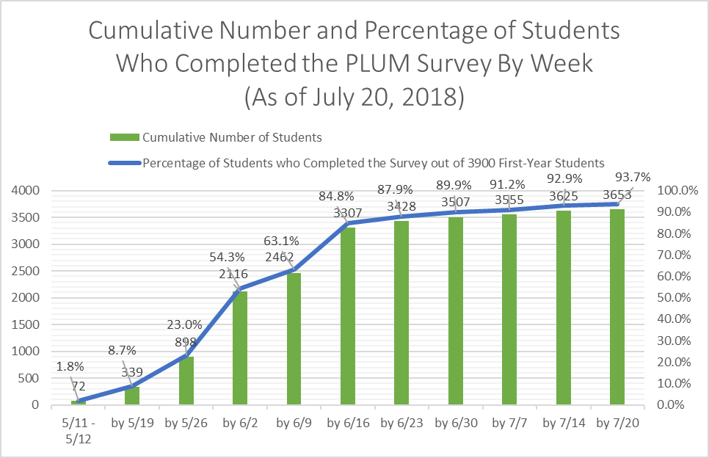
Results (2018)
July 23, 2018
  3759 students completed PLUM
  96% of incoming class
Notes:
zeigler

Slide 18
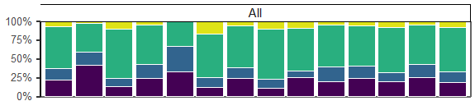
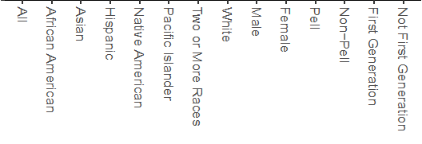
Quantitative Reasoning Category Distribution by Demographics
Notes:
QR data for Fall 2018 Freshmen: Upper left panel shows results for all colleges combined. Note in particular that African American students are about twice as likely to be in Category IV as all Fall 2018 freshmen.

Slide 19
Cultures
Poets
Algebra
PrePreCalc
B’ness
PreCalc
Calc
Stat 1
S’way 1
Calc
S’way 2
Data for Fall 2018 Freshman Cohort
Lower panels: Percent of Fall 2018 freshmen, overall and in each QR category, who took the course (including those taking the course during Summer 2019)
Upper panels: Of those who took the course and received a grade, the percent earning a grade of C- or better
Gray strip along bottom of upper panels: Number of students who took the course and received a grade
  Only QR sub-groups with at least 5 students are shown. Also, a few students didn’t have a QR category assigned. As a result, the number in “All” category may be greater than the sum of QR sub-groups.
Only first attempt at each course is included
Notes:
The Bad News: Note that Category IV students had a relatively low pass rate in all courses exempt EDUC 18 and MATH 1. Category IV students have a low pass rate in MATH 10 and MATH 12, even though these courses are specifically intended for students who are not ready for introductory statistics or pre-calculus.
The Good News: Category IV students would have in the past had to go through 1 or 2 semesters of math remediation before being allowed to take even GE math (MATH 1 or EDUC 18). But note that Category IV students had an 83% pass rate in these two courses without taking remedial math first! Most Category III students would also likely have had to take remedial math in the past, but these students had even higher pass rates (88% and 94% in MATH 1 and EDUC 18, respectively), even though they went straight into their GE math course.

Slide 20
Cultures
Poets
Algebra
PrePreCalc
B’ness
PreCalc
Calc
Stat 1
S’way 1
S’way 2
Data for Fall 2018 Freshman Cohort
Lower panels: Percent of students in each ethnicity who took the course (including those taking course during Summer 2019)
Upper panels: Of those who took the course and received a grade, the percent earning a grade of C- or better
Gray strip along bottom of upper panels: Number of students who took the course and received a grade
Only first attempt at each course is included
Foreign students and students of unknown ethnicity are included in “All”, but are not broken out separately.
Only ethnicity sub-groups with at least 5 students are shown.
Notes:
Note that African American students have relatively low success rates in several math courses.

Slide 21
Cultures
Poets
Algebra
PrePreCalc
B’ness
PreCalc
Calc
Stat 1
S’way 1
S’way 2
Data for Fall 2018 Freshman Cohort
Lower panels: Percent of students in each ethnicity who took the course (including those taking course during Summer 2019)
Upper panels: Of those who took the course and received a grade, the percent earning a grade of C- or better
Gray strip along bottom of upper panels: Number of students who took the course and received a grade
Only first attempt at each course is included
Foreign students and students of unknown ethnicity are included in “All”, but are not broken out separately.
Only ethnicity sub-groups with at least 5 students are shown.
Notes:
Note that African American students have relatively low success rates in several math courses.

Slide 22
B’ness
BioCalc
PreCalc
Stat 1
Notes:
Data for Fall 2018 freshman cohort
Numbers in the grey strips are the number of students in each group
Error bars are 95% confidence intervals (but note that these are only useful when thinking about likely variation in future cohorts. As a description of this particular group of students any difference in means is a real difference because the data include all Fall 2018 freshmen who took these courses, rather than just a sample of these students).
MATH 24: Business Math
MATH 26A: Calculus for Life Science
MATH 29: Pre-calculus
STAT 1: Introductory Statistics

Slide 23
A2 Status descriptions represent the closest a student has come to completing A2 during the first year
  Examples:
    “AP, IB, or CC Credit” means the student did not need to take an A2 course at Sac State
    “Passed ENGL 10/10M” means the student passed ENGL 10/10M (which do not fulfill A2) but did not take ENGL 11/11M or ENGL 5/5M (which do fulfill A2)
    “Failed an A2 course” means the student took ENGL 5/5M or ENGL 11/11M (perhaps more than once), but did not earn a grade of C- or better in any attempt and is not taking an A2 course during Summer
    “Did not take an A2 course” means the student did not have AP, IB or Community College A2 credit and also did not take an A2 course during the first year at Sac State.

Slide 24
Data for Fall 2018 Freshman Cohort
Lower panels: Percent of students, overall and in each WC category, who took the course (including those taking the course during Summer 2019)
Upper panels: Of those who took the course and received a grade, the percent earning a grade of C- or better
Gray strip along bottom of upper panels: Number of students who took the course and received a grade
  Only WC sub-groups with at least 5 students are shown. Also, a few students didn’t have a WC category assigned. As a result, the number in the “All” category may be greater than sum of WC sub-groups.
Only first attempt at each course is included
Notes:
Note that success in English Composition courses is relatively high overall. However, Category IV students in ENGL 5 had a relatively low success rate of only 76%.

Slide 25
Data for Fall 2018 Freshman Cohort
Lower panels: Percent of students in each ethnicity who took the course (including those taking course during Summer 2019)
Upper panels: Of those who took the course and received a grade, the percent earning a grade of C- or better
Gray strip along bottom of upper panels: Number of students who took the course and received a grade
Only first attempt at each course is included
Foreign students and students of unknown ethnicity are included in “All”, but are not broken out separately.
Only ethnicity sub-groups with at least 5 students are shown.
Notes:
Note that African American students are more likely than other students to take the ENGL 10/11 stretch sequence, rather than the single-semester ENGL 5.

Slide 26
Collaboration is Key
Mathematics & Statistics
First Year Experience
IRT
Admissions & Outreach
Advising
First Year Orientation Team
Center for College Readiness
English – Writing Program
Dean of Undergraduate Studies
Notes:
parsh

