Slide 1
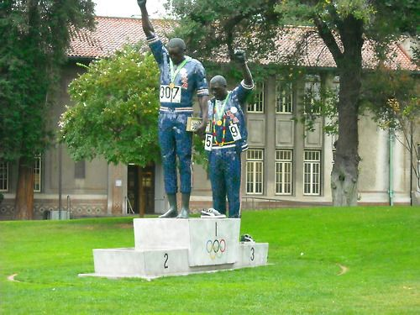
Moving from Data to Action: San José State University’s Continuous Improvement Effort in Implementing EO-1110 for Quantitative Reasoning
Ravneet Tiwana, Ph.D.
Interim Associate Director of Evaluation, Research, and Assessment
SJSU Office of Institutional Research
CSU Data Summit | February 13, 2020

Slide 2
A Few Things To Keep In Mind …
Overview
Why build a culture of inquiry in organizations?
Data humanizes us
Our missions for equitable student outcomes and opportunities
Project Design
Vision
Outcomes Framework
Assessment Design
Constructs
Administration
Results
Implementation Process
Cross-Functional Team Composition
Session Themes
Let’s Try It Out – Campus Team Discussions
Notes:
Here is an overview of today’s presentation.

Slide 3
Data Can Humanize Us
“Hiding within those mounds of
data is knowledge that could change a life
or change the world.” – Atul Butte

Slide 4
Building a Culture of Inquiry…
Data As a Source of Reflection
Widen Possibilities
Accountability & Continuous Improvement
University & Personal Missions
Passion for Social Good & Effective Impact
Rubber Meets the Road

Slide 5
Project Design
Vision
Develop a cross-functional community of practice that is evidence-informed in order to successfully implement the end of math remediation at SJSU by viewing “success” at the intersection of students’ cognitive and socioemotional development.
Outcomes Framework
EO-1110 Sub-Committee developed academic & affective student outcomes grounded in literature and measured through validated instruments along with original items.

Slide 6
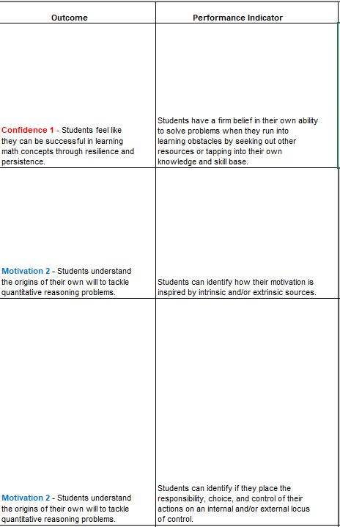
EO-1110 QR Outcomes Plan
Example Student Academic Outcomes
Example Student Affective Outcomes

Slide 7
Assessment Design
Constructs
Confidence, Extrinsic & Intrinsic Motivation, Growth-Mindset, Math Anxiety, Sense of Belonging, & College-Going Behavior.
Use of Validated Instruments
Math Attitudes & Perceptions Surveys (MAPS) (Code et. al, 2016)
Abbreviated Math Anxiety Scale (AMAS) (Hopko, 2003)
Literature and Peer Review for Original Items
Administration
First-Time Freshmen enrolled in a B4 course in Fall 2018
November –December 2019
Electronic Survey (Qualtrics)
Review Examples of Assessment Results (Tableau)
Affective Outcomes

Slide 8
Assessment Results - Overview

Slide 9
Assessment Results - Overview
IRB# F18142

Slide 10
Assessment Results – Affective Outcomes
IRB# F18142

Slide 11
Assessment Results – Affective Outcomes
IRB# F18142

Slide 12
Assessment Results – Affective Outcomes
IRB# F18142

Slide 13
Assessment Results – Affective Outcomes
IRB# F18142

Slide 14
Implementation of Cross-Functional Community of Practice
Cross-Functional Team Composition
B4 (Math/QR) Faculty whose students participated in the assessment
Director of Academic Advising
Director of Peer Connections (Supported Instruction)
Session Themes
S1 - Turning to the Literature: Ending Math Remediation During Students’ Collegiate Experience
S2 - Data Dive: Reflecting on Assessment Results (Tableau Dashboard Report)
S3 - Action Planning to Improve Practice

Slide 15
Activity- Small Group Discussion
In your CSU campus team, have a reflective discussion on the one-page data-sheet or KPI dashboards you brought to the summit.
Guiding questions located on “EO-1110 QR Community of Practice – Data Reflection & Action Planning” Sheet

Slide 16
Whole Group Reflection
What new lines of interpretation of the data developed in your group because of the varied functional areas represented in your team?
Any countering interpretations of the data based on functional area?
Thoughts on the nitty-gritty of how to imbed cross-functional reflection on data and action-planning at your campus?

Slide 17
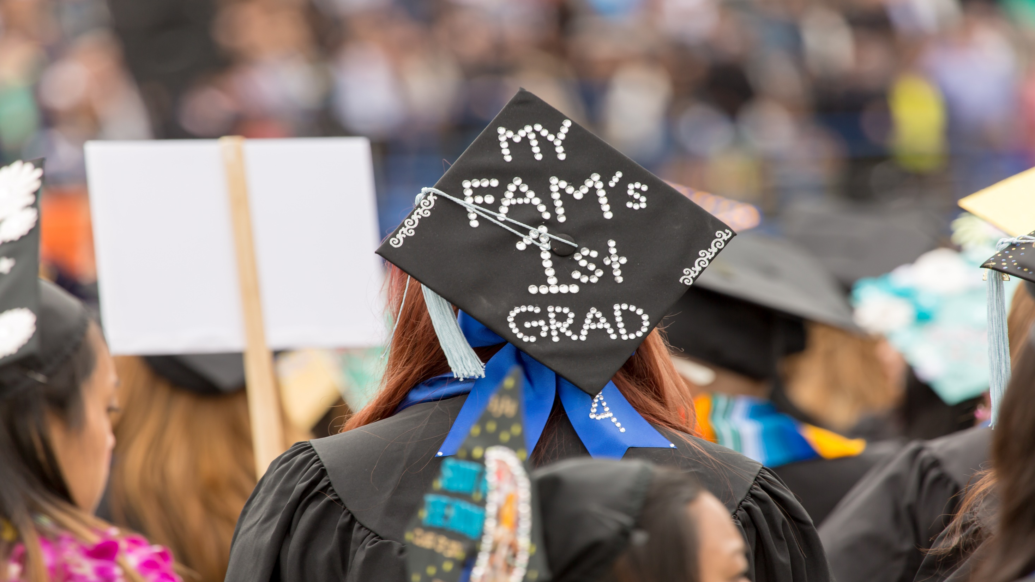
Contact Information: Ravneet Tiwana (ravneet.tiwana@sjsu.edu)
Best wishes on moving from data to action!
Photo courtesy of David Schmitz, San Jose State University

