Slide 1
Mastery-based grading at scale in GE Statistics
Introducing students (and instructors) to Mastery-Based Grading using rubrics
Friday, Feb 1, 2019
Sharona Krinsky and Silvia Heubach
California State University Los Angeles

Slide 2
Today’s environment
EO 1110 Implementation
Statistics at Scale
Lack of Preparation
Need for coordination and consistency due to scale of implementation
What does an “A” mean? What does “passing” mean?
Notes:
My name is Sharona Krinsky, I am an instructor in the math department. I have been teaching math at the university level off and on for over 25 years. Silvia Heubach and I were tasked at Cal state LA with getting our GE Statistics course ready for EO 1110 implementation. In Fall 2018, over 2,300 students took our GE Statistics course, in 90 sections with 37 instructors. Given the scale of this implementation, we needed to think carefully about how we assess this course, which is not a prerequisite course for any other course in the University. At last year’s Polyteach event, Uri Treisman presented recent research that disruptive innovation at scale is the most likely to stick.
As we began looking at the GE statistics course and realizing the scale that we would be operating at, we realized that we had a tremendous need for tight coordination as you heard previously. One of the key areas we started asking questions in was assessment. This led us to ask the questions – “What does it mean to get an “A” or to “Pass” this course?”
Specifically in GE Statistics, at our campus, there was an acknowledgement that the GE Statistics course was going to be the main GE course our non-STEM students would take, which, since many students would be coming in deemed not college ready in Math, could also result in pressure to decrease the rigor of the course.
In answering these questions, we looked at some key research findings that have been percolating at the university level in Mathematics for several years. We will be providing the notes of this talk afterwards, which include the references to this research.
In the journal “College Teaching”, Holly Hassel and Jessica Lourey published an article “The dea(r)th of student responsibility.”
“[Grade] inflation,” as Hassel and Lourey (2005) go on to state, “is a direct consequence of seeing students as customers entitled to a product (credits) that they have paid for, rather than as apprentices, and the result is a weakening of standards and a skewing of instructor and student accountability” (p. 4)
From Linda Nilson’s Specifications Grading (2007) book – “In Theory, educators agree that an A should signify an exceptional level of achievement. The student should have to display a superb command of the subject matter and the ability to apply, analyze, evaluate, and even create with it. A grade of B is supposed to indicate a good but not outstanding level of achievement – that is, at least a solid grasp of the material and the ability to perform some higher-order cognitive operations on it. A grade of C should represent a fair level of achievement, implying some mastery of most of the material and perhaps some ability to use it.
When working on the design of this course, we first looked to see how well traditional grading supports the goals of the class, the measurability of success on Student Learning Outcomes and the need to maintain the rigor and consistency of the course.

Slide 3
Traditional grading systems – Why Change?
Student learning outcomes at the course level
How to assess them?
Hunting for Partial Credit
Who has the responsibility for a grade?
Notes:
As you know, there has been a huge push in recent years to focus on student learning outcomes at the institution, program and course levels. However, assessment has traditionally been focused at the institutional and program levels, with little work to tie assessment of the success in achieving student learning outcomes at the course level. Has a student who earned an A in a course achieve all of the learning outcomes at an exceptionally high level of competency or merely at a satisfactory level? Often a passing grade in a course does not certify competency in any of the outcomes.
Partial credit turns grades into a hunt for points, the object of which is to maximize the number of points towards one’s grade with the lowest possible investment of time and effort.
This process, which can be somewhat mean spirited, does not inspire students’ motivation to learn. Nor does it seem to further their desire to improve performance. New research actually points to a decrease in internal motivation from traditional grading systems. (https://journals.sagepub.com/doi/pdf/10.1177/1469787418819728) If you lose “too many” points too early, you are potentially sunk. Students do not argue for points based on the quality of their work, but rather on any possible basis. Additionally, students and professors can be adversarial, with students trying to wheedle, cajole, and otherwise gain points being “held” by the professor. This has the effect of the professor becoming the gatekeeper of the grades, and “owning” responsibility for the students’ grade (at lease in the students’ minds).
Why change – putting responsibility for the grade back on the student. It is on them to succeed. In a minute, I’ll show you how I do that.
As we began to look at this, I brought the idea of Mastery Based Grading to Silvia, as I have been working with Mastery Grading for the last several years in Precalculus and Calculus.

Slide 4
What is Mastery-Based Grading?
Clear Standards relating course content to SLOs
Student grades dependent on quantity of material mastery at a sufficient level
Opportunities to demonstrate mastery throughout the semester
Material not related to demonstrating mastery is not assessed for final grading

Slide 5
Mastery-based grading(MBG) the Standards
Developed specific standards that tie course content directly to student learning outcomes
Sample Descriptive Statistics Standards;
D3: Describe, use and identify different types of statistical studies, including observational study, experiment, census, and sample survey.
D4: Critique and modify the design of statistical studies, including finding and repairing flaws in the study design and data collection methodologies, such as issues of confounding and blinding.
Sample Communications and Reasoning Standard:
CR3: Use both graphical and numerical summary statistics to draw conclusions about a data set or to compare different data sets. Properly use sample statistics to draw conclusions about the population, recognizing any underlying assumptions or limits of the analysis.
Notes:
For our redesigned course, we choose to use Mastery-based grading. What is mastery-based grading?
In MBG, specific standards that tie course content directly to the learning outcomes of the course are developed.
In our initial implementation in Fall 2018, we decided to use what is known as a “specifications” style set of standards – bigger, broader standards that are assessed through many problems on an exam and with a project. This implementation was not as clear and transparent to the students as we would have preferred, so for Spring 2019 we have gone to a more specific standards implementation, with 10 content standards related to Descriptive Statistics, 10 related to Inferential Statistics, and 4 standards on Communication and Reasoning.
Two examples of content standards in this semester’s course are shown above, as is one of the
Show Outcomes in Canvas and Learning Mastery Gradebook….

Slide 6
Example - assessing content
Researchers are interested in evaluating the effectiveness of fertilizer and irrigation on poplar tree health. Fertilizer is used with one group of 75 poplar trees in a sunny region, and irrigation is used with 51 poplar trees in a cloudy region. The researchers doing the measurements of tree health are aware of which trees receive fertilizer and which trees receive irrigation.
Is this an experiment or an observational study? Explain why.
Identify any problems with the design that are likely to cause confounding and explain how the problems could be avoided.
Notes:
Here is a typical exam problem for descriptive statistics.
Using a rubric grading system, this one problem allows us to assess multiple standards, and see if the students has demonstrated mastery of the material. Especially in a GE statistics class focused on consuming statistics rather than producing them, the writing component of the course has a much heavier emphasis. Therefore, grading on a rubric allows for a nuanced evaluation of the students’ work, rather than a “right/wrong” assessment.

Slide 7
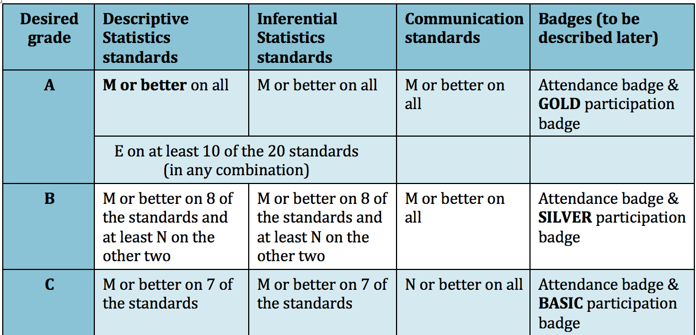
Mastery-based grading – Course Grade
Assessment of mastery in three rubric graded assignments
Levels of mastery:
Exceeds Mastery, Meets Mastery, Near Mastery, Well Below Mastery, Not Assessable
Digital badges for low-stakes participation assignments and attendance
Overall Course grade

Slide 8
Reassessment to allow for demonstration of mastery
Each statistics standard is assessed in three major assignments: in-class lab, project, and midterm
One assessment trio for descriptive and one for inferential statistics
Reassessment:
Fall 2018: final exam
Spring 2019: resubmission of assessments, retesting, final exam
Notes:
To assess the standards, students complete a lab assignment which is worked on in class in groups and then an individual report is written, a project that is individually developed and submitted, and an in class, timed exam.
For Fall 2018, if at the end of the two or three mastery graded assessments the students did not show sufficient mastery, there was one more opportunity to demonstrate mastery – the final exam. For Spring 2019, additional retesting is available, including resubmitting lab or project reports, and retesting on the midterm.
The other requirements allow for additional required work as necessary but not sufficient. Homework is necessary for success, but does not demonstrate mastery of the material. We developed digital badges, and different levels of the badges allowed students to become “eligible” for different grades, but did not contribute to them getting the grade.

Slide 9
SUMMARY
Mastery-Based Grading:
Reduces scheming and grade grubbing
Places the responsibility on students for their grades
Provides assessments that are more forgiving and track with studies in cognition
Increases metacognition and self-awareness in students
Notes:
I think you can get better, but its on you.
Moving away from points systems – what do the students think? They love it, but they don’t. They like points, but they game it.

Slide 10
Fall 2018 Standards & Results
3 broad standards – Data production, Data Analysis, and Inferential Statistics
Each assessed with three assignments
Mastery score from 1 – 6:
6 – Exceeds Mastery
4 – Meets Mastery
2 – Near Mastery
1 – Well Below Mastery
To Pass, students needed to on average, obtain a mastery score of 2.7 on all three standards.

Slide 12
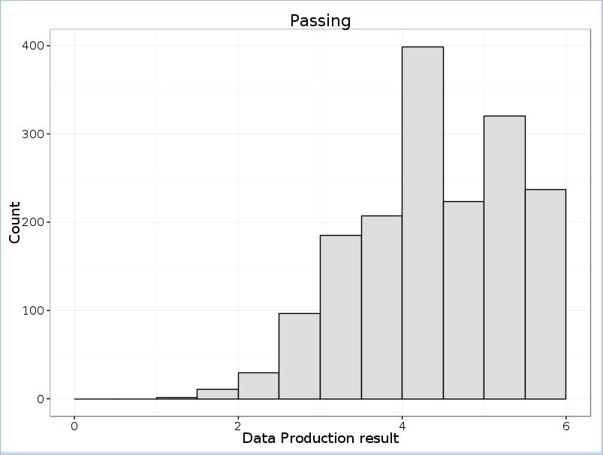
Fall 2018 Results
Data Production Mastery Score for Students who Passed
Data Production Mastery Score for Students who did not pass

Slide 13
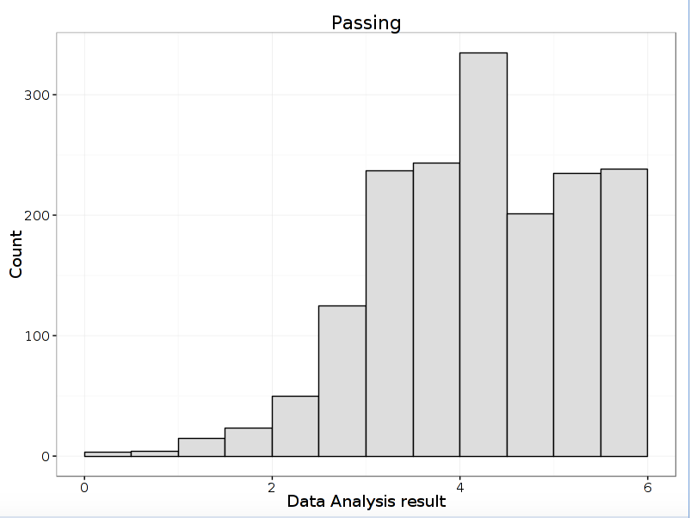
Fall 2018 Results
Data Analysis Mastery Score for Students who Passed
Data Analysis Mastery Score for Students who did not pass

Slide 14
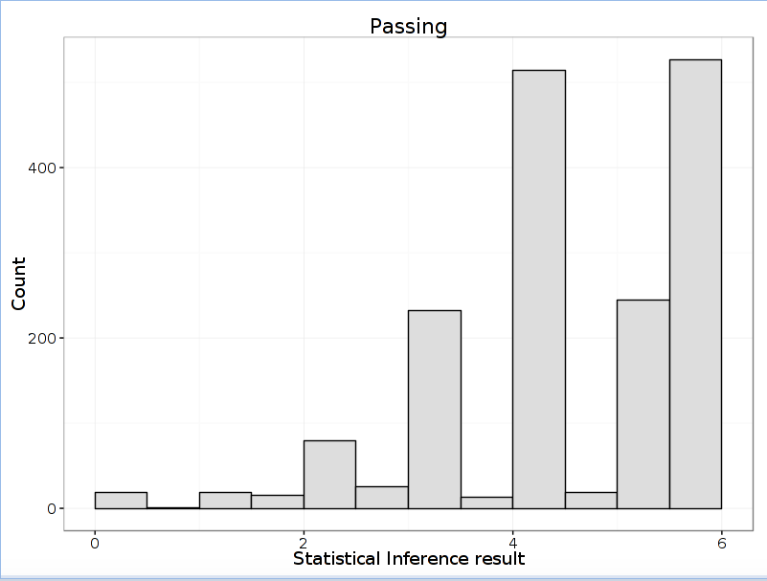
Fall 2018 Results
Statistical Inference Mastery Score for Students who Passed
Statistical Inference Mastery Score for Students who did not pass

Slide 15
What worked and what didn’t
FALL 2018
SPRING 2019
Instructors were cautiously supportive but unclear & not convinced
Students were confused
Initial three standards were too broad & vague
Overall pass rates increased from previous years
Increased focus on higher level thinking (analyze, model, create, critique)
Student Empowerment
Growth Mindset focused – opportunities to Fail Forward
Instructors are very supportive of new, more detailed standards & of MBG in general
24 total standards – additional detail & clarity, opportunity for consistent grading w/ maintained focus on higher level thinking
Student feedback incorporated into design of new standards
Videos explaining the grading system added to LMS
Increased student empowerment through additional retesting/resubmission
Notes:
The Goal of MBG is increased transparency and clarity of assessment. Fall 2018 fell short in this area, the improvements to the course for Spring 2019 should dramatically improve this.
We have an increased focus on higher level thinking through the content and reasoning standards. Students are empowered as they get to decide how hard to work to improve their grades.
Proves the need for learning outcomes that align with activities.
Growth mindset focused – every mastery graded assignment is an opportunity to learn from your mistakes, improve, and try again.

