Slide 1
Redesigning College Algebra for Inquiry
Topaz Wiscons, Department of Mathematics and Statistics

Slide 2
An elusive and persistent gulf exists between research in mathematics education and the practices of mathematics classrooms, in many countries in the world.
-Jo Boaler, Bridging the gap between research and practice: international examples of success, 2008

Slide 3
Literature Review: Benefits of IBL
Increased student learning outcomes (Laursen, Hassi, Kogan, Hunter, & Weston, 2011)
Attitudinal gains, especially for women and lower-achieving students (Laursen et al., 2011)
Increased motivation, development of beliefs about mathematics (Bruder & Prescott, 2013)
Active learning increases student performance in STEM (Freeman et al., 2014)
Notes:
CBMS statement, MAA instructional practices guide,

Slide 4
Literature Review: Challenges for Implementation
Instructors did not learn via IBL; this is new
Workload
Being alone, lack of institutional support
Student resistance
Tenure/evaluation concerns
Relinquishing control in the classroom
(Chin & Lin, 2013)
(Hayward, Kogan, & Laursen, 2016)
Notes:
CBMS statement, MAA instructional practices guide,

Slide 5
Introduction
We know…
IBL instruction is good
IBL instruction is difficult to implement
How do we implement IBL instruction course-wide
with instructors who are new to IBL?

Slide 6
Background
August 2017:
Executive Order 1110
Redesign Both College Algebra Courses
Let’s Use IBL!
(Inquiry Based Learning)
How do we Support our Instructors and Our Students?

Slide 7
Goals for this Talk
Design Process
Support Structures
(Students and Faculty)
Preliminary Results

Slide 8
Design Process
Learning Outcomes for Math 10/12: Cull the foundational topics and concepts for downstream success
Assemble a document of exercises to achieve these goals:
Promote Inquiry
Develop Analytical Skills
Contextualize/Decontextualize info
”Soft-Skills”
How to effectively use the textbook/office hours/SI
Promote Mathematical Identities
Encourage Mathematical Confidence

Slide 9
Old Materials, Systems of Linear Equations

Slide 10
Old Materials, Systems of Linear Equations

Slide 11
Old Materials, Systems of Linear Equations

Slide 12
Old Materials, Systems of Linear Equations

Slide 13
New Materials, Systems of Linear Equations

Slide 14
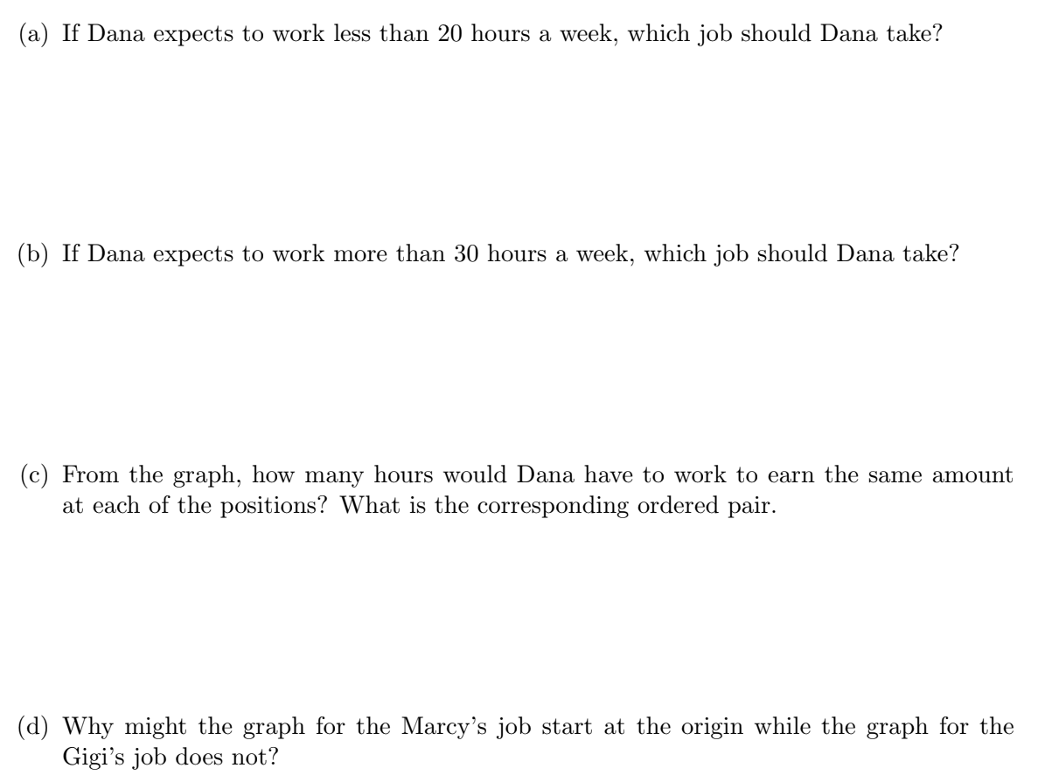
New Materials, Systems of Linear Equations

Slide 15
Support Structures
Instructors
Across section coordination of both course
Weekly meetings
Weekly overview topics & structure
Shared groupwork assignments
Shared homework
Common exams
Created community among instructors
IBL workshop (October 2018)
Pre-empt potential impact of student evals by having dialog with Chair
Students
Supplemental Instruction (SI)
Math 10 – PARC (1 unit)
Math 12 – PAL (1 unit)
Commit to 2 hours/week in Math Lab
Small class size
Facilitates groupwork and creates community among student

Slide 16
Support Structures
Instructors
Across section coordination of both course
Weekly meetings
Weekly overview topics & structure
Shared groupwork assignments
Shared homework
Common exams
Created community among instructors
IBL workshop (October 2018)
Pre-empt potential impact of student evals by having dialog with Chair
Students
Supplemental Instruction (SI)
Math 10 – PARC (1 unit)
Math 12 – PAL (1 unit)
Commit to 2 hours/week in Math Lab
Small class size
Facilitates groupwork and creates community among student

Slide 17
Challenges from Instructor Survey
Student-buy in
Facilitating productive group learning can be difficult
Rooms designed for lecture format, not cooperative learning
Preparing for the unknown is time consuming
Lack of confidence among instructors

Slide 18
Positive Outcomes from Instructor Survey
Common theme: having a teaching community was helpful
“There was significantly more communication between students… students became comfortable asking each other questions and working together”
“It’s waaaaaay more fun to teach this way…”

Slide 19
Preliminary Student Outcomes
Math 10: 7% DFW rate
Average grade: 2.85
Math 12: 14.5% DFW rate
Average grade: 2.59

