Slide 1
Supporting Students with the Lowest Placement in the Calculus Pathway
Florence Newberger
California State University, Long Beach

Slide 2
CSULB’s Calculus Pathway Before
College Ready + Intermediate Algebra
Precalculus Algebra
One-semester Calculus for Biology
Calculus for Engineering and Physical Science
Precalculus Trigonometry
Not College Ready
CSULB Math Placement

Slide 3
CSULB’s Calculus Pathway After
College Ready
+ Intermediate Algebra
Precalculus Algebra
Precalculus Trigonometry
Not College Ready
CSULB Math Placement

Slide 4
CSULB’s Calculus Pathway After
College Ready
Essential Algebra A
Not College Ready
Co-requisite
Precalculus Algebra
Precalculus Trigonometry
Essential Algebra B
CSULB Math Placement
GE B4

Slide 5
CSULB’s Calculus Pathway After
College Ready
Essential Algebra A
Not College Ready
Co-requisite
Precalculus Algebra
Precalculus Trigonometry
Essential Algebra B
CSULB Math Placement
GE B4
GE B4

Slide 6
CSULB’s Calculus Pathway
College Ready
Essential Algebra A
Not College Ready
Co-requisite
Precalculus Algebra
Precalculus Trigonometry
Essential Algebra B
CSULB Math Placement
GE B4
GE B4
Weekly meetings
Two 50-minute large lectures
One 2-hour 30-student activity
One 2-hour 30-student co-requisite (M3, M4)
Fall 2018: 340 Students
181 (M2) and 159 (M3, M4)

Slide 7
Why aren’t these students taking GE QR math or statistics?
These students chose to work toward majors that require algebra or calculus.
Engineering and Physical Science
Biology
Health Sciences
Goals for Essential Algebra A
Help them prepare for the technical major they selected, or
Get them to pass the course while they are figuring out that they really don’t want to do that major after all.

Slide 8
Episode IV: A New Hope
Chapter 1
After-you-needed-it algebra
Chapter 2
Who passed Exam 1?
Chapter 3
If it ain’t broke, don’t fix it.

Slide 9
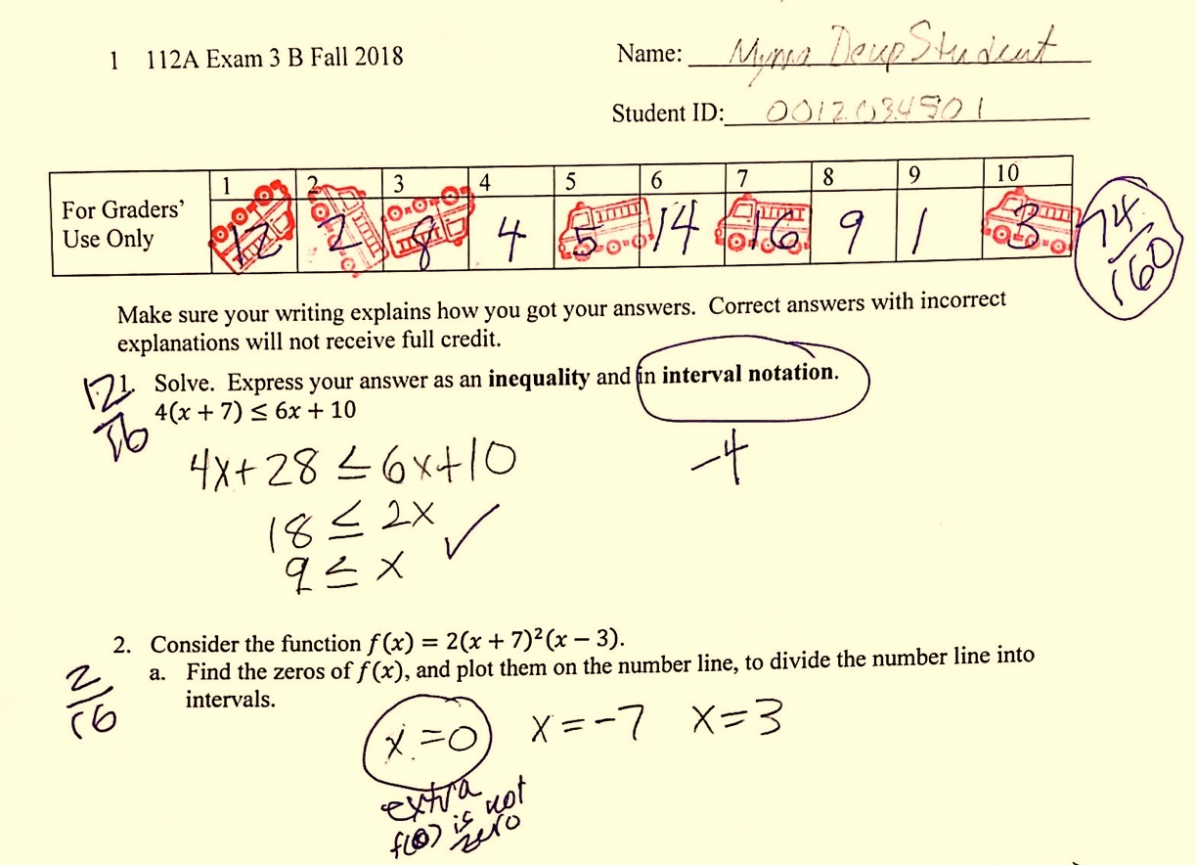
Chapter 1 After-you-needed it algebra support
Who: Students who scored below 70% on an exam
What: Revised their incorrect exam problems, and completed similar problems
Why: To become confident enough to be able to study this content independently in preparation for the final and future work, and to earn a score of 70% on the exam
When: During office hours
How: With the help of their peers and instructors.
Where: *problem

Slide 10
Impact
 | Exam 1 | # of Students | % who improved their score on Exam 2
Whole class |  | 138 | 68.0%
Passers | ≥70% | 162 | 63.6%
Correctors | ≤70% and corrected | 73 | 79.5%
Non-correctors | ≤70% and didn’t correct | 103 | 67.0%

Slide 11
Chapter 2 Who passed Exam 1?
Number of students
Still working on it
Mastered 70%
of the content

Slide 12
Chapter 3 If it ain’t broke, don’t fix it
Co-requisite support session includes students with a wide variety of preparations.
Some of them do not need or want extra help.
To pass the co-requisite, students must earn 70 points.
Task | Points | Total possible
Attend a session | 5 | 70
Earn 70% on a quiz in the parent course (before or after corrections) | 2 | 16
Get 100% on an online homework in the parent course | 1 | 23
Earn 70% on an exam (before or after corrections) | 10 | 30

Slide 13
Epilogue
We accommodated the wide variety of student preparations by producing two ways to earn a passing grade:
Prepare sufficiently for exams and pass them, or
Correct errors and rehearse ideas with instructors and peers to learn exam content after the fact.
P.S. We need classroom space for our office hours.
Not all students in the co-requisite course need support, and some students not in the co-requisite course do need support.
We gave students some control over the degree to which they participated in the co-requisite support, by having multiple ways to earn credit.
Pass rate for the course was 76%.

