Slide 1
Professional Development & Coordination of GE Statistics at Cal State LA
February 1, 2019. Silvia Heubach & Sharona Krinsky

Slide 2
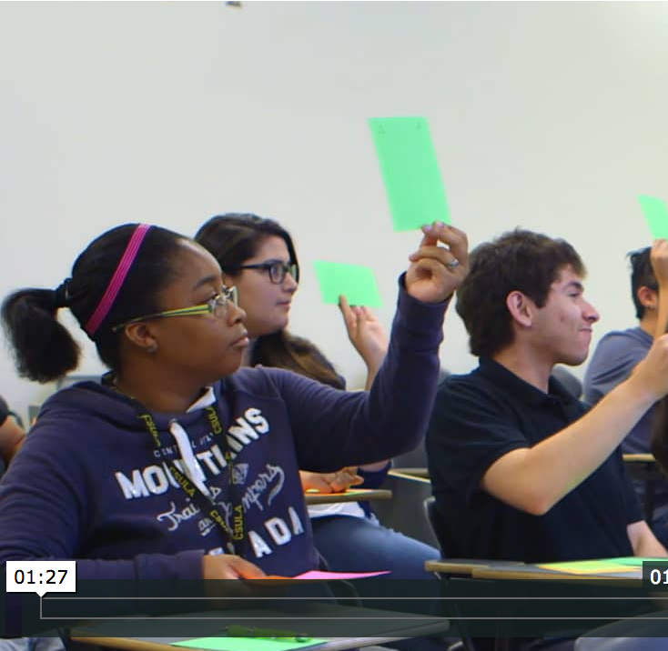
Professional Development for GE B4 Instructors

Slide 3
Professional Development
What did professional development look like at YOUR campus?
Pull out your smart phones
Go to https://kahoot.it/
Enter the displayed game pin
Answer the question

Slide 4
Professional Development at Cal State LA
Long-term professional development
ACUE course on effective teaching strategies
Designing an Effective Course & Class
Establishing a Productive Learning Environment
Using Active Learning Techniques
Promoting Higher Order Thinking
Assessing to Inform Instruction & Promote Learning
Crucial for success: All pathway leads participated and personally invited instructors
Instructors were paid a stipend if they completed the first half of the ACUE course and were given opportunity to continue to obtain the ACUE certificate
Notes:
ACUE course is 25 modules; we required 12 and attendance at 2 in person meetings. Payment was $750.

Slide 5
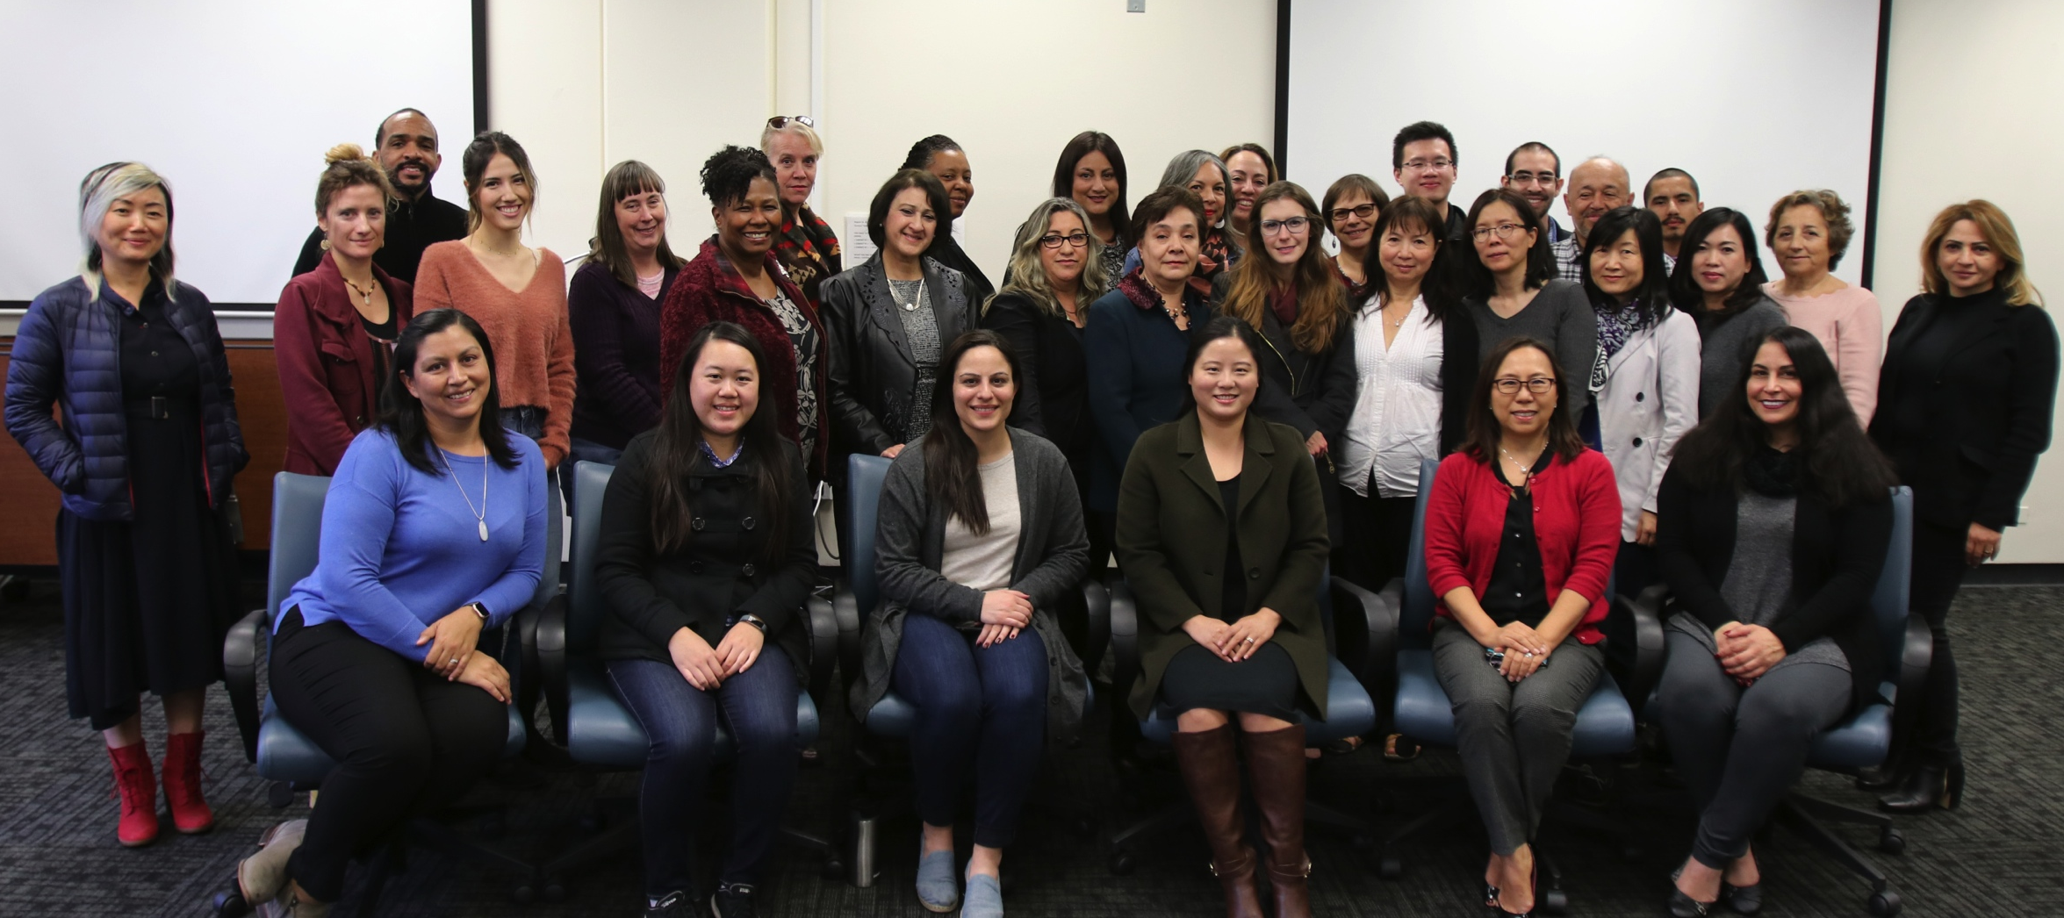
Cohorts
Spring 2018 cohort
Fall 2018 cohort
46 instructors started the course, 9 dropped out early
The remaining 37 instructors completed at least 7 of the 12 modules
35 instructors (nearly 95%) completed the first half of the course (12 modules)
25 instructors (68%) completed all 25 modules by the end of Fall 2018 and obtained the ACUE certificate
21 instructors started the course
11 instructors completed 12 modules
2 additional instructors completed at least 6 modules
8 instructors (including two from the Spring 2018 cohort) are continuing in the Spring 2019 semester
Note: Instructors need to be teaching to be able to do ACUE course
Notes:
If comparing to 46, then have 76% completion rate for first half;
If comparing to 46, then have 54%

Slide 6
Professional Development at Cal State LA
Half-day workshops
Non-course specific – Teaching Math Conceptually
training for Early Start and Fall GE instructors
Identified 67 instructors involved in these courses
All but 2 attended the training sessions
Course-specific – Pedagogy, Course-in-a-box, Technology/LMS
QR Math 1000/1100 (12 instructors; 4 did not attend)
Math 1090/91 (32 instructors; 30 attended) – offered multiple dates
Precalculus (51 instructors; 10 did not attend)
Notes:
Sharona did the non-course specific training

Slide 7
Result: Change of culture
ACUE training created a Faculty learning community in the department
Instructors now have common vocabulary
Sense of community and ownership
Brought adjunct and FT faculty closer together
Several adjunct faculty were involved as course-specialists

Slide 8
Coordination of Introductory Statistics

Slide 9
Coordination
What did coordination of Quantitative Reasoning GE courses look like on YOUR campus?
Pull out your smart phones
Go to https://kahoot.it/
Enter the displayed game pin
Answer the questions
Notes:
Tell audience members to answer for their particular course if they are coordinating, and otherwise pick one of the coordinated courses..

Slide 10
Math 1090/1091 Overview
Fall 2018
Spring 2019
80 sections of Math 1090 at Cal State LA and 6 sections at high schools (SLAM) for a total of ~ 2300 students
37 sections of Math 1091 at Cal State LA with a total of ~ 900 students (43%)
A total of 39 instructors at Cal State LA
Almost all sections of Math 1091 taught by instructors who are also teaching Math 1090
Parent and co-req sections were not tied together
16 sections of Math 1090 at Cal State LA for a total of ~ 400 students
15 sections of Math 1091 at Cal State LA with a total of ~ 270 students (69%)
A total of 13 instructors; two new instructors
Almost all sections of Math 1091 taught by instructors who are also teaching Math 1090
Parent and co-req sections were tied together
Notes:
There is also a stats course taught by the Charter College of Education (headed by Deborah OH). These slides report on the Math 1090/91 course only, even though some of the issues also arose for the EDFN 1090/91. The structure of the course is the same, but the implementation differs.
Math 1090 – 2122 students CSULA; 213 SLAM; total 2337

Slide 11
Math 1090/1091 Coordination Fall 2018
Created blue-print Canvas Courses for Math 1090/1091
Instructors were provided with course materials (lesson plans, I-Clicker slides and assignments)
Common midterm and final exams
Grading rubrics and Excel Grading tool for labs, projects and exams
Norming sessions for applying grading rubrics
Command Central – created Canvas course to house resources for instructors and facilitate communication between coordinators and instructors
Weekly meetings – had four different sessions recorded sessions via Zoom and posted concerns/solutions/ideas from sessions in Command Central
Notes:
Exams – variations across sections, identical for sections taking place at same time or in time slot immediately after.
In Spring we still have three sessions (ZOOM)

Slide 12
Results for Math 1090 in Fall 2018
1090 grade NC = D+, D, F, NC
1091 NO = did not take Math 1091
Pass rate for students who took Math 1091: 70.4%
Pass rate for students did not take Math 1091: 79.0%

Slide 13
Content Modifications for Spring Semester 2019
Math 1090
Modified standards for mastery grading and clarified grading scheme for students (and instructors)
Adjusted pacing
Math 1091
Introduced participation badge and dropped algebra skill badge
Added different types of assignments
Vocabulary activity
Activities on how to read a math text
Moved common assignments to support course
Math autobiography, goal setting, growth mindset
Notes:
Exams – variations across sections, identical for sections taking place at same time or in time slot immediately after.

Slide 14
Course Modifications for Future Terms
For Fall 2019, we will have two versions of Math 1090
Math 1090/91 for students who require math support (cohorted)
Math 1092 for Category I or II students; they can elect to take the supported version
Math 1090 and Math 1092 will have the same content
Will have two flavors (Fall and Spring) of these courses for mastery-graded assignments and some of the common assignments
Notes:
Also Math 1001/01 and Math 1002

