Slide 1

Year Two Planning:
Assessing Progress, Celebrating Achievements,
and Looking Forward

Slide 2
Meeting Outcomes
Campus teams will:
Review progress to enrich student success while maintaining rigor
Analyze disaggregated data from Year 1
Identify milestones achieved in Year One, set campus-specific student success and equity goals for Year Two, and backwards map a plan for achieving them
Collaborate with CSU colleagues and learn from their successes

Slide 3
Observations, Expectations, Opportunities
- A Round Table Discussion
Brian Jersky, CSU Long Beach
Neal Finkelstein, WestEd
Martha Ellis, Charles A. Dana Center

Slide 4
Using data to Improve Teaching and Learning

Slide 5


Slide 6

CSU Year 2 Planning Meeting
Dr. Martha Ellis, Director of Higher Education Strategy, Policy, and Services, Charles A. Dana Center
Dr. Desiree Zerquera, Assistant Professor, Department of Leadership Studies, University of San Francisco

Slide 7
Group Norms
Make equity central.
Focus on fulfilling our charge.
Seek clarification in language and ideas to increase understanding.
Understand that those who work, learn.
Look for solutions, not blame.
Focus on systems, not people.
Recognize that everyone has expertise.
Be honest.
Share talk time.

Slide 8
Equity-Focused, Data-Informed and
Action-Oriented
Collaborating Across Campus
Desiree D. Zerquera, Ph.D., Dana Center
Notes:
Intro: 5 minutes
10-10:05
Session Segments
Developing and Applying Anti-Deficit Lenses for Examining Quantitative Data
Engaging with Data
Individual Reflections
Group Discussion
From Data to Action: Developing a Year 2 Agenda
Outcomes
Identify inequities in opportunity within restructured writing and mathematics courses
Understand and apply anti-deficit lenses to interpreting quantitative student outcome data
Collaborate with representatives across their own campus to interpret quantitative student outcome data and develop plans for action

Slide 9
Opening Reflections
As you’ve wrapped up year one of your work in restructuring developmental education, what are your most significant achievements from the past year?
What are some of your ongoing concerns as you enter year two?
How can data be more helpful for you in this work?
Notes:
10:05 – 10:10

Slide 10
Developing and Applying Anti-Deficit Lenses for Examining Quantitative Data
Notes:
10:10 – 10:25

Slide 11
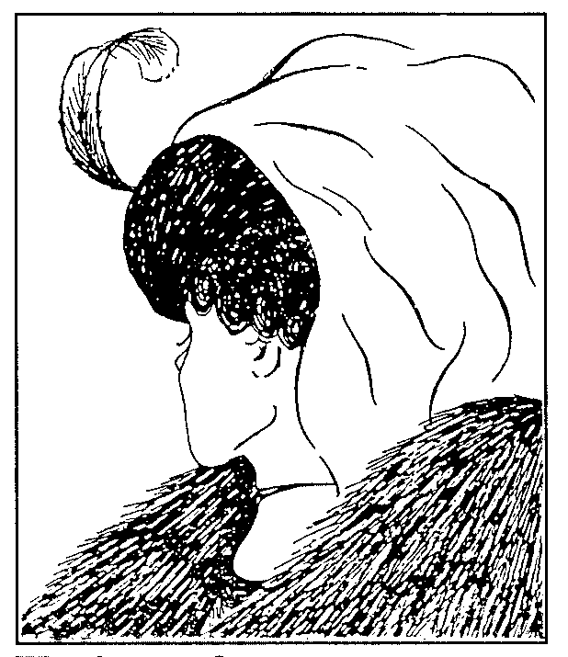
Understanding the Ways we Understand the World
We each have paradigms that guide our thought patterns and actions
Not necessarily limited or fixed
  Can use multiple paradigms at the same time
  Your own worldview can evolve

Slide 12
Deficit-Based Paradigms
deficit (Merriam-Webster):
  an amount that is less than the amount that is needed
  the amount by which a person or team is behind in a game or contest
  a problem that causes a decrease in some ability
Cultural deficit model within education (Irizarry, 2009)
  stems from negative beliefs and assumptions regarding the ability, aspirations, and work ethic of systematically marginalized peoples

Slide 13
Deficit-Based Paradigms
Assertions & Assumptions
  students of color & low-income students fail to succeed because of “cultural deprivation”
  their families do not value education in the same ways that their middle- and upper-class White counterparts do
  upper and middle-class students are more likely to do well in school because they possess more cultural capital
  l
Manifestations & Implications
  Idea that we need to “fix” students
  Shifts blame from institutions to students for students’ struggle/failure
  Stereotype threat (Steele, 1997)

Slide 14
Deficit-Based Paradigms in Understanding Quant Data
Use of certain demographics to predict or explain outcomes
  The strongest predictors of students’ success in Mathematics courses was being African American, coming from a low-income household, and being in a course taught by part-time faculty
  Latinx students are three times more likely to fail English courses than their White counterparts

Slide 15
Expanding Anti-Deficit Paradigms for Understanding Data
“Equity-mindedness” among faculty and practitioners (Bensimon, 2007)
  cognizant that exclusionary practices, institutional racism, and power asymmetries impact opportunities and outcomes for minoritized students
  attribute unequal outcomes to institution-based dysfunctions instead of originating from student characteristics
  reflect on their own and their colleagues’ role in and responsibility for student success

Slide 16
Centering Equity in Our Data Lenses
Commit to anti-deficit framing of data outcomes and analyses
  Place institutional responsibility at the core of the work
Foreground and center underserved populations
  Identify opportunity gaps
  Foster unapologetic focus
  Explore intersectional disaggregation
Employ creativity in data analysis
  Explore alternative ways of conducting & presenting analyses
  Include broad audience in data collection and interpretation
Notes:
Tend to think of data as separate from equity

Slide 17
Applying Anti-Deficit Paradigms for Understanding Quant Data
The strongest predictors of students’ success in Mathematics courses was being African American, coming from a low-income household, and being in a course taught by part-time faculty
  Across pre-baccalaureate mathematics/quantitative reasoning courses:
    Low-income African American students are more likely to be in courses taught by part-time faculty
    Success rates in courses taught by part-time faculty are significantly lower than those taught by full-time faculty
    Just 20% of these courses are taught by full-time faculty
Latinx students are three times more likely to fail English courses than their White counterparts
  Across written communication courses:
    CSU-X was more successful in supporting White students than Latinx students to successful course completion
    The institution had greater success rates with Latinx students placed in courses with support vs. students placed in courses without support

Slide 18
Engaging With Your Campus Data
Notes:
10:25 – 11:45 (total)

Slide 19
Engaging with Your Campus Data Part 1: Individual Reflections
Emote & React
Identify Key Points
Pose Questions
Notes:
What might others in the room be doing during this time? → help with problem solving if campuses don’t bring data
What if they didn’t bring all the data? → perhaps sit with another campus that did bring data. [will then during action planning think about the data they don’t have – questions they’d like to have answered; how would like to use it; ways own understanding could be supported; help they need that CSU system can help with]

Slide 20
Engaging with Data: Individual Reflections
Emote & React
Cognitive Dissonance (Festinger,1957)
psychological conflict resulting from simultaneously held incongruous beliefs and attitudes
l
produces a feeling of discomfort leading to an alteration in one of the attitudes, beliefs or behaviors to reduce the discomfort and restore balance
l
discomfort must be alleviated
  change in one or more of the attitudes, behaviors, beliefs (hard to change well-learned behavior
  acquire new information that challenges the dissonant beliefs
  reduce the importance of the new beliefs/attitudes
Notes:
compared to the same drive as hunger or thirst
strength of feeling of discomfort shaped by commitment to the challenges values/beliefs & regard/attitudes towards source of challenge to our beliefs

Slide 21

Engaging with Data: Individual Reflections
Review the data gathered for today’s session
regarding student outcomes from year one of efforts
Individually, jot down your immediate reactions, thoughts, feelings
  What are your thoughts on this data?
  What emotions do these data trigger for you?
  What “WTF” questions do you have about these data?
  In what ways do these data trigger discomfort for you?
  How are you immediately responding to that discomfort?
  In what ways is what’s shown here similar/different from what you expected to find?
Notes:
10:25 – 11:45 (total)
End this reflection by 10:40

Slide 22
Engaging with Data: Individual Reflections
Emote & React
Identify Key Points
Identifying key points in the data
Interpretation points should
  Speak directly to the data at hand
  Note trends, points of comparison
  Highlight gaps in the data presented
  Connect to your own personal expertise for interpretation
  Apply equity-mindedness
Interpretation points should NOT
  Be solutions
  Be completely independent of data presented
  ONLY use your personal expertise

Slide 23

Engaging with Data: Individual Reflections
Review the data
Note four interpretation points
  Where are key differences? Similarities?
  Consider who is and who isn’t captured in the data
  Where are Gaps?
  What is true for the majority (numbers wise)?
  Who/what group is differently affected?
  What is the ideal number we would want to see here? How is what is shown here in relation to that ideal?
Notes:
May want to focus on one tab or table; there’s a lot of data. This is just for them to focus
Consider exploring different tables across the table [encourage this]
10:25 – 11:45 (total)
End this reflection by 10:50

Slide 24

Emote & React
Identify Key Points
Pose Questions
Engaging with Data: Individual Reflections
What more do you want to know?
What additional questions do these data points raise for you?
  Better understanding students’ experiences
  More information about courses students take, who teaches them, and how
  Deeper information about success before, during, after the course
  Understanding the ecology of students’ experiences—faculty teaching courses, advisors and practitioners supporting them
Notes:
10:25 – 11:45 (total)
End this reflection by 11:00

Slide 25
Engaging with Your Campus Data Part 2: Group Reflections
Articulating Key Opportunity Gaps
Discussing Potential Explanations

Slide 26
Engaging with Data: Group Reflections
Articulating Key Opportunity Gaps
In small groups (2-3)
  May wish to group with others
  within similar role on your campus
  One by one, compare the key data points
  you highlighted in your review of the data
  Note overlaps, new insights
  Highlight key points in the data across all
  Note opportunity gaps in the data
l
Then, share across campus
  By group, present key points in data you highlighted
  On poster paper, write out all of your key data points across insights
  l
Rules for engagement
  Listen to understand
  Challenge through inquiry vs. opposition
  Value all voices and insights
  Center equity-mindedness
Notes:
Most groups won’t be large enough for this; 2-5
Incorporate flexibility if there are smaller groups, larger groups
10:25 – 11:45 (total)
End this entire Section by 11:25

Slide 27
Engaging with Data: Group Reflections
Discussing Potential Explanations
Regroup into small groups with
those in similar roles
Consider potential explanations for
data points
Note separately on post-its and
stick next to data point they
correspond with
Guidelines
  Leverage your own funds of knowledge, qualitative data, other data, personal experience, anecdotal evidence
  Note additional data questions you have that would help you better understand these data
  l
Rules for engagement
  Listen to understand
  Challenge through inquiry vs. opposition
  Value all voices and insights
  Center equity-mindedness

Slide 28
Engaging with Data: Group Reflections
Discussing Potential Explanations
Review as a group
  Each small group present
  their ideas to the rest of the team
  Pose questions to one another,
  seek overlap in ideas
Rules for engagement
  Listen to understand
  Challenge through inquiry vs. opposition
  Value all voices and insights
  Center equity-mindedness
Notes:
--Incorporate flexibility for different group sizes, representation
--***aware of that dynamic between IR and the rest
10:25 – 11:40 (total)
End this section by 11:40

Slide 29
From Data to Action
Developing an Agenda for Year 2

Slide 30
Moving Forward
What action steps do you propose from these data?
  Not necessarily solutions to problems inferred; can also help deepen you understanding, point to other data efforts needed
  Must connect directly to the data points you identified
Consider implications for
  Data capacity, Policy, Practice
  Examples
    Collaboration between IR staff and others on campus
    Enhancing understanding & dissemination of course-level data
    Curriculum design
    Student support efforts: evaluation, addition, revision
    Faculty engagement: full- and part-time professional development
Notes:
In the afternoon session there will be more of a connection of the action steps from the morning to lead these general conversations. Will then take this in developing their plan during the afternoon session.
--consider implications: consider framing the actual IR folks as partners but how to better use them ongoing as thought partners to inform practice—both data and the people who are there too. Incorporate examples.
End by 11:55

Slide 31
Lunch Sessions
Provide space for facilitated roundtable discussions across campuses

Slide 32
LUNCH ROUND TABLES
Shared Responsibility for Student Success
– Los Angeles
Professional Development of Instructors, Advisors, and Counselors: Teaching Experts – It’s Harder than It Looks
– Santa Barbara/Santa Monica
Assessment, Evaluation, and Research
– California Salon B
Aligning Supported Course Structures to Student Needs the Second Time Around
– California Salon C

Slide 33
Effective uses of planning and communication

Slide 34
Meeting Outcomes
Campus teams will:
Review progress to enrich student success while maintaining rigor
Analyze disaggregated data from Year 1
Identify milestones achieved in Year 1, set milestones for Year 2, and backwards map a plan for achieving them
Collaborate with CSU colleagues and learn from their successes

Slide 35
Completion and Equity
CSU Graduation 2025 Initiative lays out ambitious goals for increasing degree attainment and achieving equitable outcomes.
Placement and remediation reform are essential components to reaching these goals.

Slide 36
Communication and Engagement

Slide 37
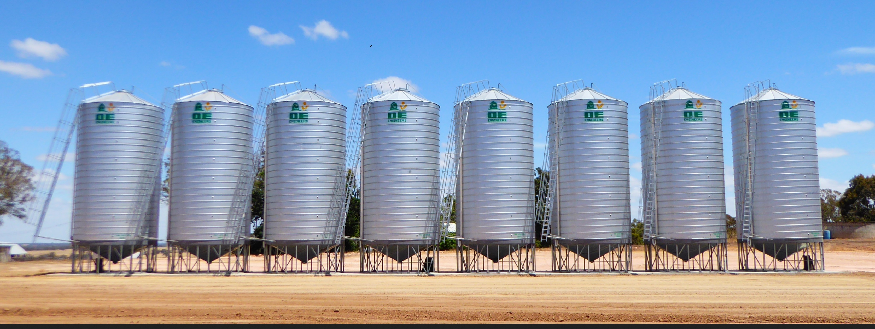
Working in Silos: Institutional Landscape
Advising
Career
services
Tutoring
Financial
Aid
Academic Departments
Orientation

Slide 38
Communication and Engagement
This work will require communication and engagement across the institution.
Communication disseminates information;
it builds awareness.
Engagement encourages people to process and act upon information; it builds ownership.

Slide 39
Vision

Slide 40
Clarity
Be straightforward
Listeners’ point of view
Monitor people’s reaction
Headline or soundbite
Speak to heart as well as mind

Slide 41




WHAT
HOW
WHY
Knowing your WHY is not the only way to be successful, but it is the only way to maintain a lasting success and have a greater blend of innovation and flexibility (p.50)
Notes:
Vison of the future that does not yet exist

Slide 42

Know the obstacles to campus engagement

Slide 43
Creating a Communication Plan
Define broad goals.
Consider the needs of different audiences.
Define the strategies.

Slide 44
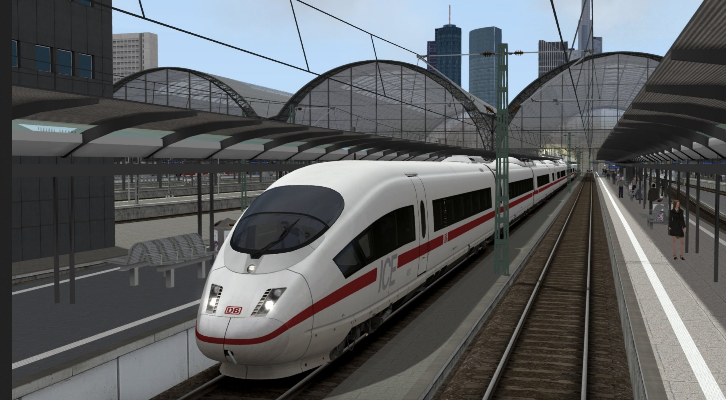
Where are we going?
The need to use DATA to guide us.
We must understand WHY we create change.

Slide 45
Milestones for Continuous Improvement
Notes:
Now is the time to plan for the future. How can we continue to improve student success to meet your graduation 2025 goals?

Slide 46
Culture: Capacity to Use Data to Inform Change
Questions
Answers
Impact
Meaning
Asking the Right Questions that lend themselves to being answered by data
Using data to inform decision-making and necessary changes to impact results
Moving from information to knowledge
Shared responsibility
Finding the right answers to the questions you’re asking
Involved process
Reflects strength of institutional data processes
Making data real and actionable on your campus
Notes:
Highlights multiple stages in the process of the culture around data at the institution, the shared responsibility for upholding data in our processes, and the responsibility to use that data for impact

Slide 47

Every number is a person

Slide 48
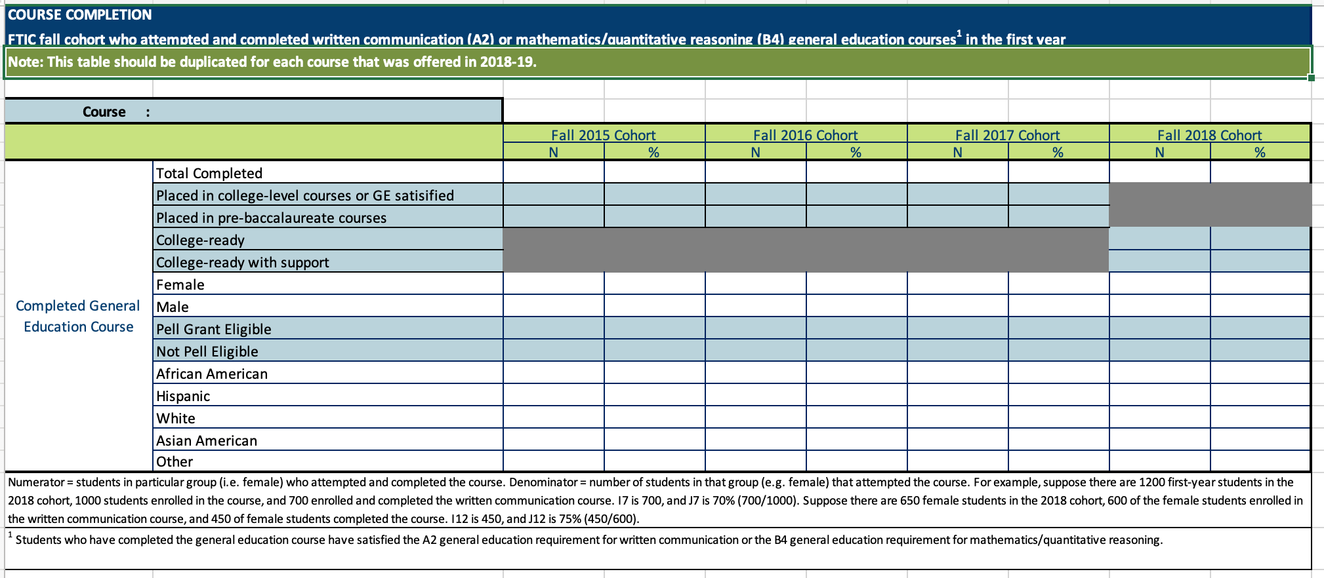
What story does the data tell?
Notes:
Based on your data and progress from this year, we will begin to work on a plan for year 2.

Slide 49

Next Institutional Action Steps
Get your disaggregated institutional data
Identify the shareholders for this work
Create a new asset-based narrative
Identify which educational milestones to focus on
Create benchmarks for institutional progress

Slide 50
Mid-Term Planning
With the goals for scale in mind, set mid-term goals for Fall 2020.
Work backwards from Fall 2020 to establish a timeline for key actions and deliverables.

Slide 51
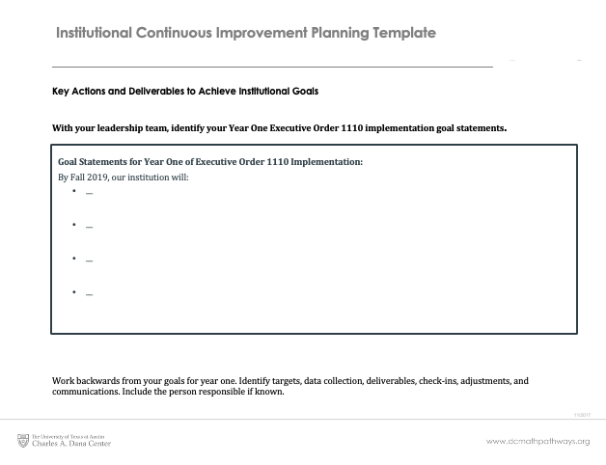
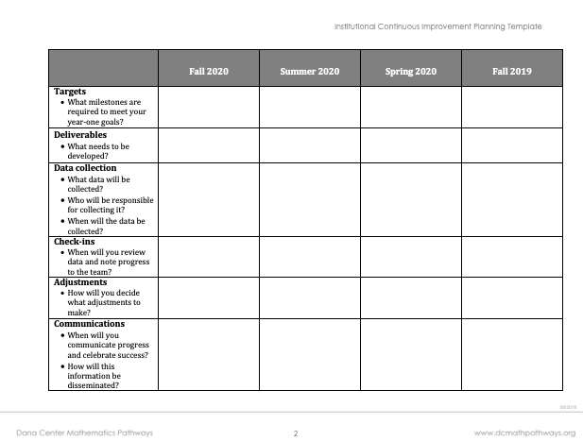
Revisiting the Continuous Improvement

Slide 52
Communication Goals
Discussion:
Draft one or two communication goals for the next 2 months. What do you need to communicate?
Notes:
Story from data brought

Slide 53
Sample Timeline of Activities
Sept.
Oct.
Nov.
Dec.
Jan.
Feb.
Mar.
Apr.
May
June
Jul.
Aug
Data collection
Regional Meetings
Advisor training
Faculty professional development
Plan for continuous improvement
Campus focus groups
Faculty professional development
Faculty attend workshops
Fall 2020 schedules due
Classes Begin
Leadership team and creates implementation plan for year 2

Slide 54

Planning for Year 2
Identify 2 goals for year 2…
Goals
Strategies to reach these goals

Slide 55
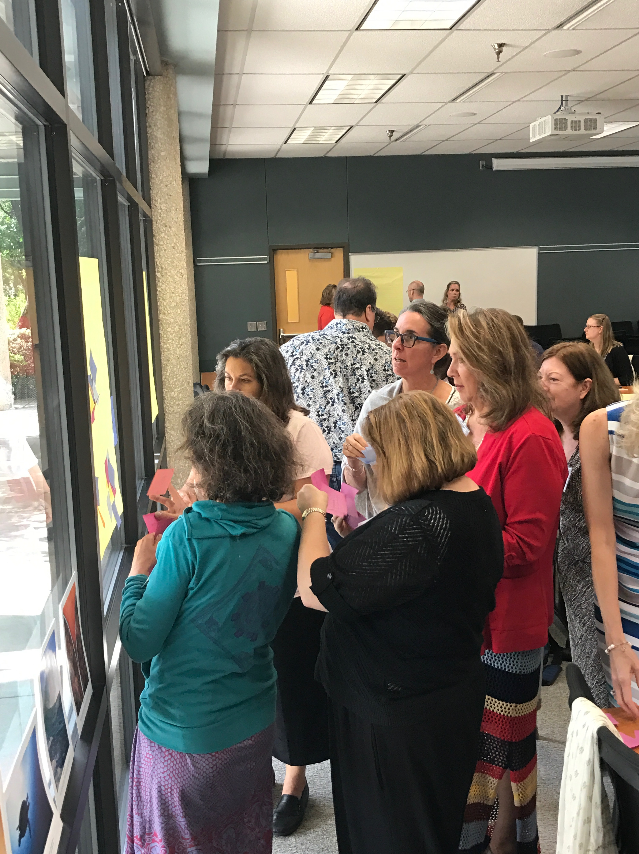
Snacks and Gallery Walk
Record ideas that resonate with you based on your role on your campus team
As a team, identify ideas that you are excited about or want to learn more about

Slide 56
Year 2 Planning Wrap-Up
Revisit your Continuous Improvement Planning Template. Capture any additional next steps.

Slide 57

Institutional level action occurs at the speed of trust,
with open communication,
shared meaning,
and sustained commitment.

Slide 58


Notes:
As you know, this work is about the students. After working with the students for the Fall semester, it is time for us to look at the lessons learned and thing about progress planned.

Slide 59
Contact information
General information about the Dana Center:
www.utdanacenter.org
Dana Center Mathematics Pathways Resource Site: www.dcmathpathways.org
To receive monthly updates about the DCMP, contact us at: dcmathpathways@austin.utexas.edu
Notes:
Facilitator notes: Update this slide with relevant, current contact information.

Slide 60
About the Dana Center
The Charles A. Dana Center at The University of Texas at Austin works with our nation’s education systems to ensure that every student leaves school prepared for success in postsecondary education and the contemporary workplace.
Our work, based on research and two decades of experience, focuses on K–16 mathematics and science education with an emphasis on strategies for improving student engagement, motivation, persistence, and achievement.
We develop innovative curricula, tools, protocols, and instructional supports and deliver powerful instructional and leadership development.
2016
Notes:
This slide is included for print – it is not part of the presentation.

