Slide 1
CSU Mathematics/Quantitative Reasoning Supportive Course Workday
MDTP
Tool
A for Teachers
Informed placement Friday March 9, 2018
Kimberly Samaniego, Ed. D.
Director CSU/UC Mathematics Diagnostic Testing Project (MDTP)
Director UCSD Mathematics Testing and Placement

Slide 2
Informed Placement
MDTP
Tool
A for Teachers
Established Placement Policy
Experiments to Inform a Placement Policy

Slide 3
Examples of Experiments to Inform a Policy
MDTP
Tool
A for Teachers
Diagnostic Results a Key Criteria for Decision-Making
UCSB Student Informed Placement
CSU Projects
UCSD Undergraduate Math Readiness Project

Slide 4
UCSB Student Informed Placement
MDTP
Tool
A for Teachers
Former policy
Students took a self-placement test on online and unproctored
Students earning 100% could register for Calculus
Students received solutions when they completed the exam so they could retake the exam as many times as they wanted to receive 100%
Exploration 2017-18 Academic Year (n = 1020)
MDTP Calculus Readiness Online (designed for placement at UCLA)
Parallel items for three unique tests
Students took at home, un-proctored, printed their results and brought to their counseling/enrollment meetings
Notes:
346 (D) + 353 (E) + 321 (F) = 1020

Slide 5
UCSB Student Informed Placement
MDTP
Tool
A for Teachers
“We are loving the MDTP online test. We find that it really helps our students to be placed into courses that they are truly ready for.
We believe this type of placement exam is a much more efficient way than a self-assessment exam, as students won't be able to register for a certain class unless we clear them ourselves.
With a self-placement exam, students would be able to register for whatever they wanted to regardless of their suggested placement” (UCSB Math Faculty).

Slide 6
CSU SF Exit Diagnostic
MDTP
Tool
A for Teachers
Precalculus Students and MDTP Calculus Readiness
Students take an in-house Calculus Placement exam (even if they take Precalculus at CSUSF)
May 2017 Administration (end-of-course)
Proctored in class faculty in Math 199 (11 instructors, 272 students) and Math 226 (18 instructors, 825 students)
Next steps: Propose new policy to enhance student access to Calculus

Slide 7
CSU LA ESM Diagnostic
MDTP
Tool
A for Teachers
Early Start Math 310/320 MDTP Secondary Algebra Readiness (Faculty Eyob Demeke)
Two summer sessions: 4-weeks offered 4 hours each day
1900 students enrolled in Math 310 (Beginning Algebra) and Math 320 (Intermediate Algebra)
All students took proctored SR45A06 for pre and post-test
Diagnostic results were used to evaluate intervention and propose/inform design for future support
Demeke, E., Lawson, A., Samaniego, K. (2018, February). Cooperative Learning and Its Impact on Developmental Mathematics Courses: A Case Study in a Minority-Serving Institution. Poster Session presented at the Special Interest Group of the Mathematical Association of America on Research in Undergraduate Mathematics Education, San Diego, CA. (SIGMAA RUME)

Slide 8
UCSD Undergraduate Math Readiness Project
MDTP
Tool
A for Teachers
MDTP Diagnostic Tests specifically designed by MDTP Workgroup and UCSD undergraduate Math Faculty
Math 2
Math 3C/4C (Precalculus and STEM Precalculus)
Math 10A/20A (Calculus and STEM Calculus – first quarter)
Math 10B/20B (Calculus and STEM Calculus – second quarter)
Online and non-proctored (timed 70 minutes)
Students print qualitative results and send to their professors
Students use results to advocate for additional support
SI Sessions, Tutors, and Specially Designed Tutor Sessions on MDTP Topics
Increased collaboration between Math Department and Teaching + Learning Commons
Implications on course design, instruction, student supports during the academic year, and student matriculated summer programs

Slide 9
Kimberly Samaniego, Ed.D.
MDTP
Tool
A for Teachers
Director Mathematics Diagnostic Testing Project (MDTP)
Director Math Testing and Placement, UCSD
ksamaniego@ucsd.edu
mdtp.ucsd.edu

Slide 10
MDTP
Tool
A for Teachers
Common Items – Purposeful Design
Math 2
Math 3C Math 10A
7 items
Math 2 Math 3C
19 items
Math 3C Math 10A
19 items
Math 3C Math 10A Math 10B
4 items
Math 10A Math 10B
18 items
All 4 tests
3 items

Slide 11
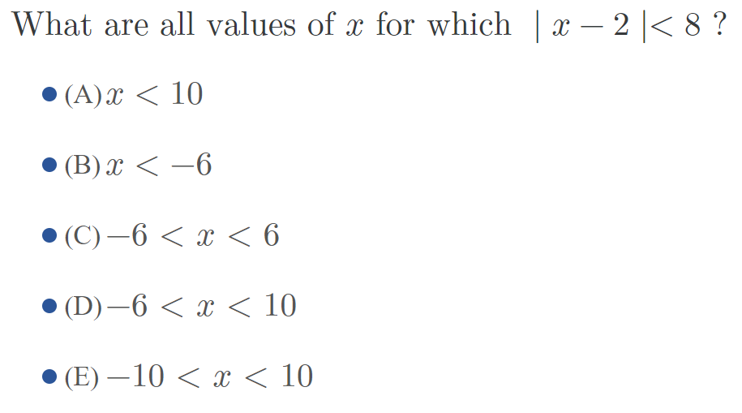
Math 2 (n=83)
Math 3C (n=480)
Math 10A (n=1067)
Math 10B (n=847)

Slide 12
Math 2 (n=83)
Math 3C (n=480)
Math 10A (n=1067)
Math 10B (n=847)

Slide 13
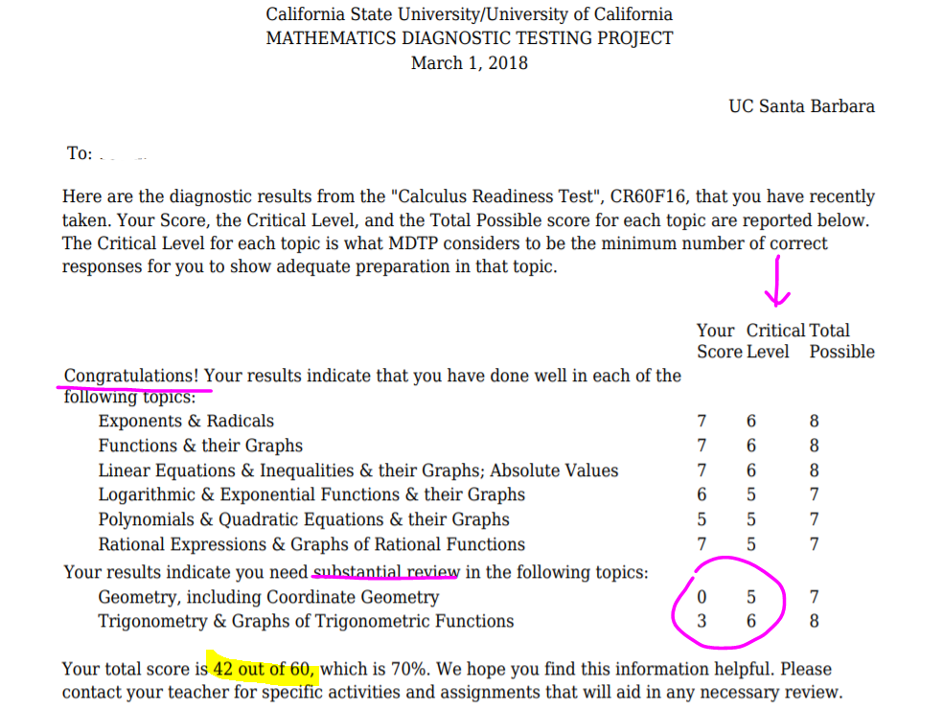
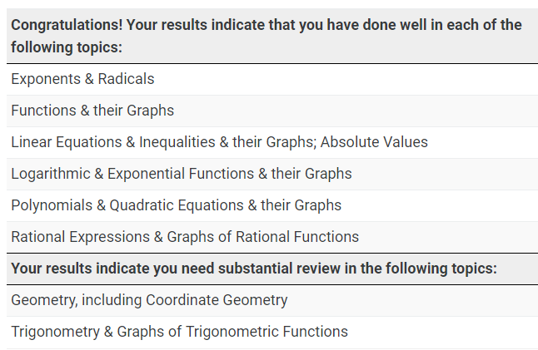
PDF Results
(includes quantitative results)
Student Results
(includes qualitative results)

Slide 14
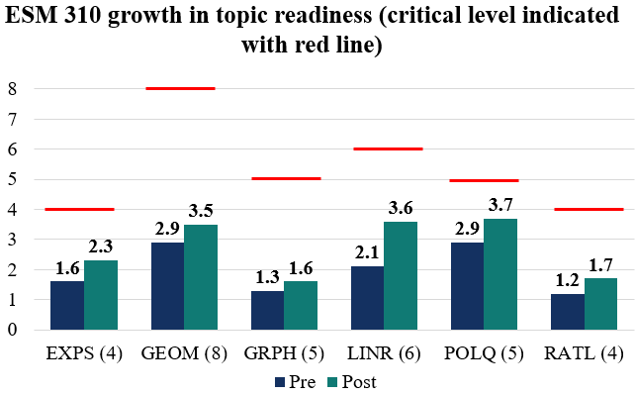
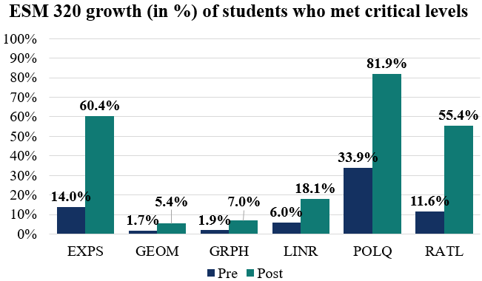

Slide 16
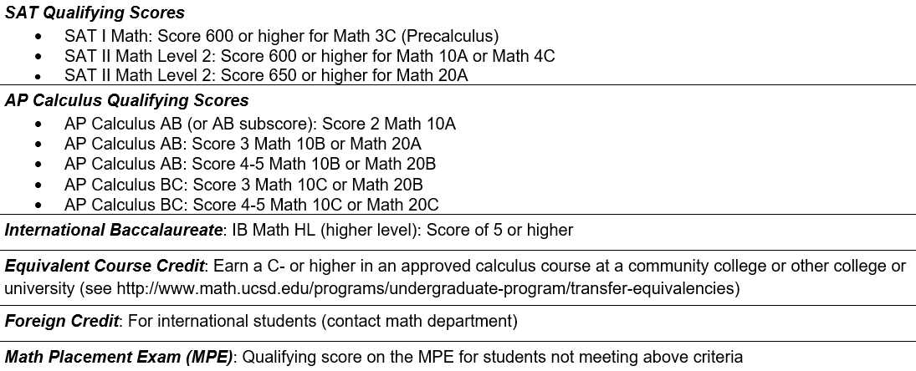
Example of Established Policy UCSD
MDTP
Tool
A for Teachers
CCC
CSU
UC
MPE = 24% UCSD students
Math 2 (Introduction to College Mathematics)
3C/4C (precalculus and STEM precalculus)
10A/20A(calculus and STEM calculus)
Notes:
41 CCC used MDTP for the 2016-2017 academic year; CAI abandoned; compass sunset; Accuplacer in use
8 CSU used MDTP for the 2016-17 academic year; ELM sunset
UCSD 1800 MPE

